Slide 1



Enabling Efficient and Scalable Read Disturbance Mitigation via New Experimental Insights into Modern Memory Chips
Abdullah Giray Yaglikci
agyaglikci@gmail.com
https://agyaglikci.github.io
13 March 2024
Microsoft Cambridge
agyaglikci.github.io
safari.ethz.ch
Notes:
Hi my name is Giray and I am happy to share my research with you

Slide 2

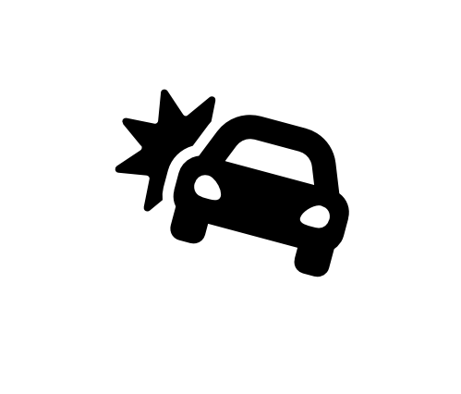


Lack of Memory Isolation
Data Loss or Corruption
access
Compromise Application Correctness
1 → 0
Leak Private Information
Memory
Take Over a Computer
An access to one memory address
should not have unintended side effects
on data stored in other addresses
Memory isolation is difficult in modern memory chips
Notes:
I will start with a brief background on memory isolation, a fundamental primitive for system security and privacy [CLICK]
Imagine that you access a memory location, and a bitflip occurs in some other location [CLICK]
Prior works show that if this happens

Slide 3
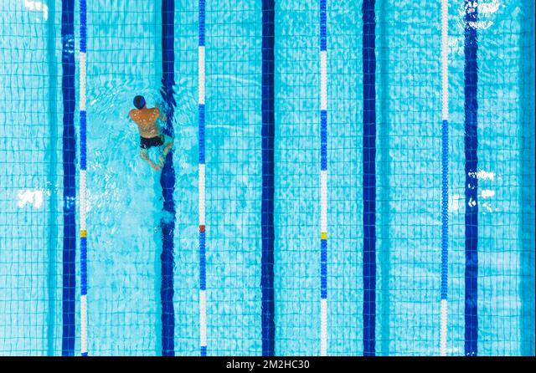
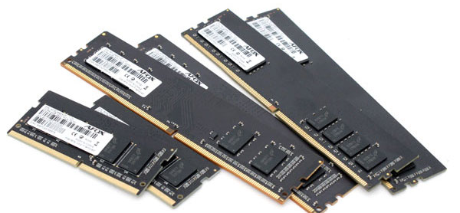
DRAM Read Disturbance
Used Lane
Swimming in a lane disturbs
nearby lanes
Bitflips
Read
Bitflips
Reading from a memory location disturbs data in physically nearby locations
Notes:
Unfortunately, [CLICK]
an access to a DRAM region, [CLICK]
disturbs the data in other physically nearby regions and this phenomenon is called DRAM read disturbance [CLICK]

Slide 4
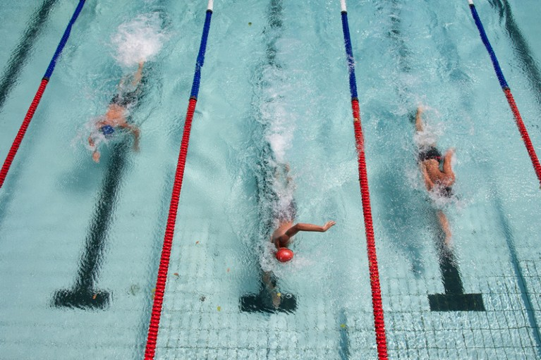
DRAM Read Disturbance – Swimming Pool Analogy
Swimming in a lane disturbs nearby lanes
Notes:
Let me explain read disturbance with an analogy of a swimming pool[CLICK]
With multiple lanes [CLICK]
A swimmer uses only the middle lane [CLICK]
but by creating waves, causes disturbance in nearby lanes [CLICK]

Slide 5
The RowHammer Vulnerability [Kim+, ISCA’14]
DRAM Subarray
Row 0
Row 1
Row 1
Victim Row
Row 2
Row 2
Row 2
Row 2
Row 2
Row 2
open
open
open
closed
closed
Aggressor Row
Aggressor Row
Row 3
Row 3
Row 2
Victim Row
closed
Row 4
Repeatedly opening (activating) and closing (precharging)
a DRAM row causes RowHammer bitflips in nearby cells
and breaks memory isolation
Notes:
Due to an increase in cell-to-cell interference, as a result of aggressive technology node scaling, rapidly activating [CLICK] and precharging
[FORTH & BACK] a DRAM row can result in bit flips in physically adjacent rows [CLICK]
[FORTH & BACK] Continuing to access the same row results in even more failures in nearby rows. This phenomenon is known as RowHammer. [CLICK]
We refer to the rapidly accessed row as an aggressor row and the rows containing bit flips as victim rows.

Slide 6
An Example RowHammer Mitigation: Preventive Refresh
DRAM Subarray
Row 0
Row 0
Row 0
Victim Row
Row 1
Row 1
Row 1
Row 1
Victim Row
Row 2
Row 2
Row 2
Row 2
Row 2
Row 2
open
open
open
closed
Aggressor Row
Aggressor Row
Row 3
Row 3
Row 3
Row 3
Victim Row
Row 4
Row 4
Row 4
Victim Row
Refreshing potential victim rows mitigates read disturbance bitflips

Slide 7
Motivation
Technology Scaling
[Kim+, ISCA’14]
[Kim+, ISCA’20]
[Luo+, ISCA’23]
DRAM chips are increasingly more vulnerable to read disturbance with technology scaling
Notes:
With technology node scaling, DRAM chips are getting more vulnerable to read disturbance [CLICK]
and defenses become prohibitively expensive [CLICK]
Therefore, we need a deeper understanding of DRAM read disturbance [CLICK]
to provide effective and efficient solutions [CLICK]

Slide 8



Two Main Types of DRAM Refresh
Periodic Refresh:
Periodically restores the charge which DRAM cells leak over time once in every 32ms or 64ms
1
2
Preventive Refresh:
Mitigates read disturbance by refreshing potential victim rows
Putting into Perspective:
Bitflips occur at ~1000 row activations scattered across 64ms
64ms is as large as to accommodate 1,280,000 activations
An attack needs only 0.08% of the activation budget
1280 rows can be concurrently hammered
1280 additional refreshes are needed
Notes:
DRAM Refresh is mainly used for two purposes [CLICK]
The first one is called: Periodic Refresh to periodically restore the charge that DRAM cells leak over time [CLICK]
The second one is relevant to a read-disturb error mechanism called RowHammer, where repeatedly accessing a DRAM row can cause bit flips in other physically near by rows [CLICK]
A common method of mitigating RowHammer is refreshing potentially affected rows, called preventive refresh [CLICK]

Slide 9
Two Main Types of DRAM Refresh
Periodic Refresh:
Periodically restores the charge which DRAM cells leak over time once in every 32ms or 64ms
1
An attacker can keep low profile (e.g., uses 0.08% of activation budget)
and induce bitflips
2
Preventive Refresh:
Mitigates read disturbance by refreshing potential victim rows
Preventing bitflips requires
tracking many rows and performing many refreshes
Putting into Perspective:
Bitflips occur at ~1000 row activations scattered across 64ms
64ms is as large as to accommodate 1,280,000 activations
An attack needs only 0.08% of the activation budget
1280 rows can be concurrently hammered
1280 additional refreshes are needed
Notes:
DRAM Refresh is mainly used for two purposes [CLICK]
The first one is called: Periodic Refresh to periodically restore the charge that DRAM cells leak over time [CLICK]
The second one is relevant to a read-disturb error mechanism called RowHammer, where repeatedly accessing a DRAM row can cause bit flips in other physically near by rows [CLICK]
A common method of mitigating RowHammer is refreshing potentially affected rows, called preventive refresh [CLICK]

Slide 10
How Large is 1000 Activations?
Bitflips occur at ~1000 activations
Mitigation mechanisms trigger preventive actions (e.g., preventive refresh) at ~500 activations
Is 500 a distinctive activation count?
Benign workloads activate hundreds of rows more than 512 times in a refresh window
Memory intensive workloads from SPEC’06/17, TPC, YCSB, and MediaBench
Benchmark | MPKI | # of Rows w/ ACT count >512
429.mcf | 68.27 | 2564
470.lbm | 28.09 | 664
519.lbm | 24.37 | 2482
434.zeusmp | 22.24 | 292
510.parest | 17.79 | 94
437.leslie3d | 15.82 | 7
483.xalancbmk | 13.67 | 113
482.sphinx3 | 12.59 | 304
505.mcf | 11.35 | 732
471.omnetpp | 10.72 | 122
tpch2 | 9.09 | 88
520.omnetpp | 9.00 | 32
tpch17 | 7.43 | 26
* Row counts are across all banks
Sorted

Slide 11
How Large is 1000 Activations?
Bitflips occur at ~1000 activations
Mitigation mechanisms trigger preventive actions (e.g., preventive refresh) at ~500 activations
Is 500 a distinctive activation count?
Benign workloads activate hundreds of rows more than 500 times in a refresh window
Memory intensive workloads from SPEC’06/17, TPC, YCSB, and MediaBench
Benchmark | MPKI | # of Rows w/ ACT count >512
429.mcf | 68.27 | 2564
470.lbm | 28.09 | 664
519.lbm | 24.37 | 2482
434.zeusmp | 22.24 | 292
510.parest | 17.79 | 94
437.leslie3d | 15.82 | 7
483.xalancbmk | 13.67 | 113
482.sphinx3 | 12.59 | 304
505.mcf | 11.35 | 732
471.omnetpp | 10.72 | 122
tpch2 | 9.09 | 88
520.omnetpp | 9.00 | 32
tpch17 | 7.43 | 26
Benign workloads might not be so benign
even if they are not very memory intensive
Sorted

Slide 12
Read Disturbance is an Outstanding Problem
Increasing DRAM chip density
exacerbates DRAM read disturbance
Attackers can keep low profile
(using <0.16% of the row activation budget)
Benign applications become not-so-benign
Efficient and scalable solutions are needed

Slide 13
Thesis
A deeper understanding of
DRAM read disturbance
is the key to enable
efficient and scalable solutions

Slide 14






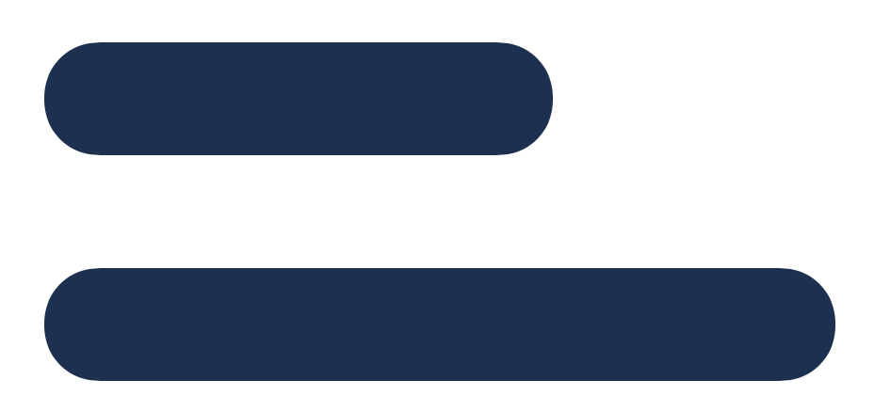
My Dissertation Works
A deeper look into DRAM read disturbance
Solutions to DRAM read disturbance
Temperature
Memory access patterns
Victim cell’s physical location
Voltage
Leveraging
Heterogeneity
Throttling Unsafe Accesses
Parallelizing Preventive Actions
Notes:
I also developed solutions that [CLICK]
throttle unsafe accesses [CLICK
parallelize maintenance operations [CLICK]
and leverage heterogeneity [CLICK]
Let me quickly explain one of these works [CLICK]

Slide 15
Our Recent Works
Temperature
Memory access patterns
Victim cell’s physical location
Leveraging
Heterogeneity
Notes:
I also developed solutions that [CLICK]
throttle unsafe accesses [CLICK
parallelize maintenance operations [CLICK]
and leverage heterogeneity [CLICK]
Let me quickly explain one of these works [CLICK]

Slide 16
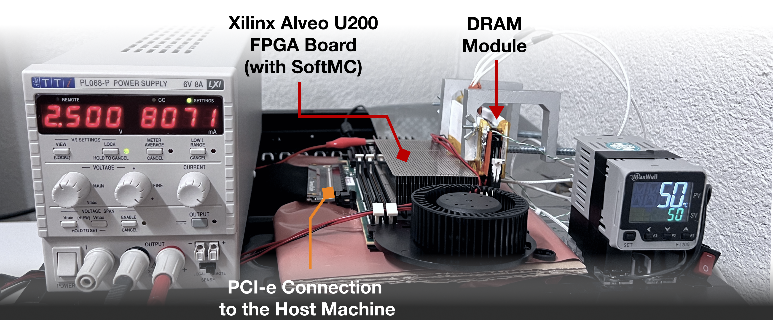
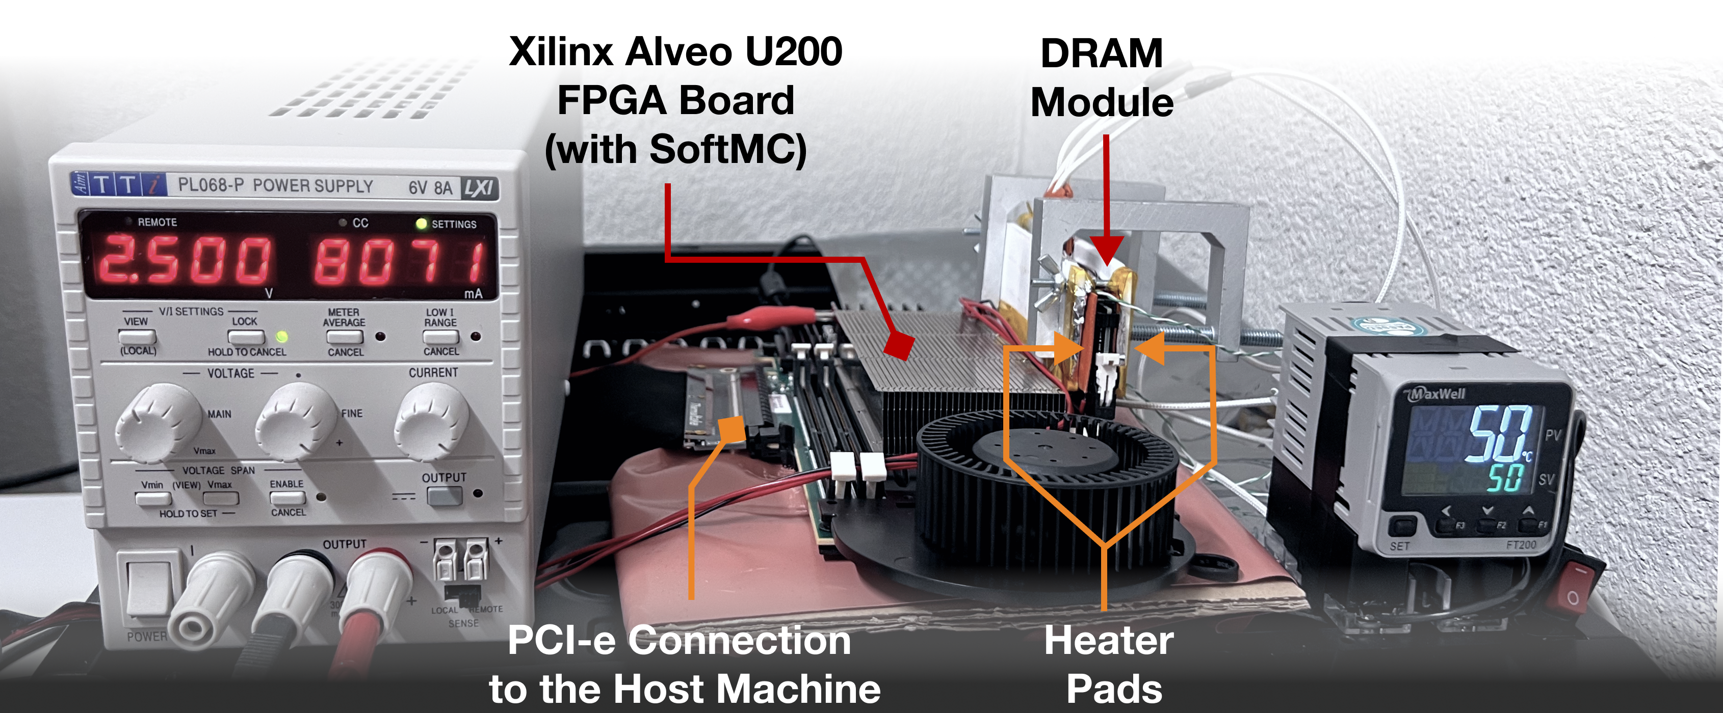
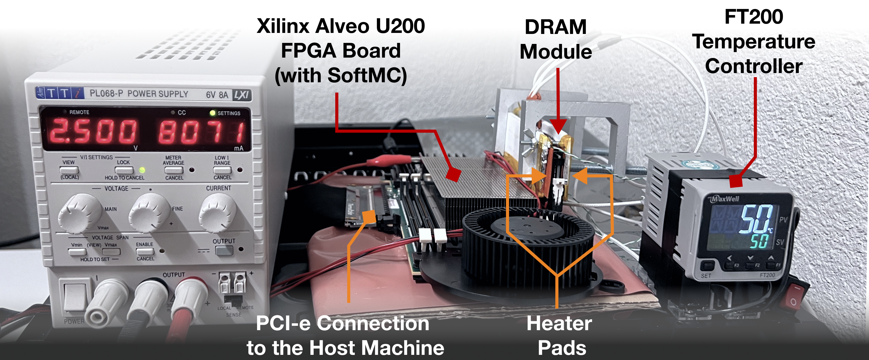
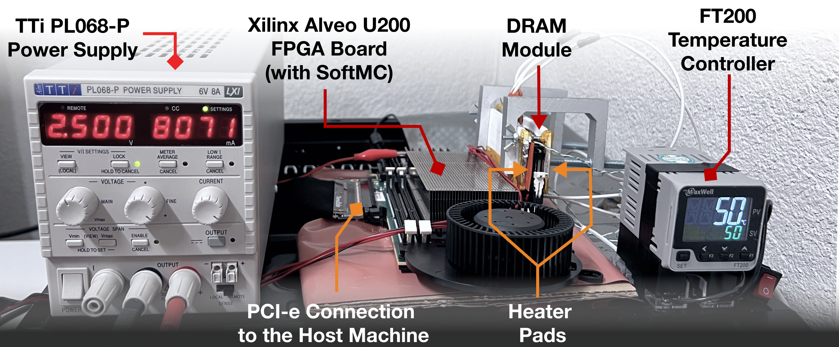
DRAM Testing Infrastructure
DRAM Bender on a Xilinx Virtex UltraScale+ XCU200
*
Fine-grained control over DRAM commands,
timing parameters (±1.5ns), temperature (±0.5°C ),
and wordline voltage (±1mV)
*Olgun et al., "DRAM Bender: An Extensible and Versatile FPGA-based Infrastructure to Easily Test State-of-the-art DRAM Chips,” in TCAD, 2023. [GitHub: https://github.com/CMU-SAFARI/DRAM-Bender]
Notes:
We use an FPGA-based experimental setup programmed with a modified version of SoftMC [CLICK]
We control the chip temperature using a pair of heaters [CLICK] connected to a temperature controller [CLICK]
We supply the wordline voltage using the VPP power rail from an external power supply [CLICK]
This infrastructure provides fine-grained control over DRAM commands, timing parameters, temperature, and wordline voltage [CLICK]
=======

Slide 17
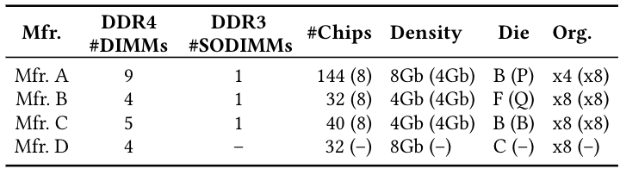
DRAM Chips Tested
Two DRAM standards
Mfr. | DDR4 DIMMs | DDR3 SODIMMs | # Chips | Density | Die | Org.
A (Micron) | 9 | 1 | 144 (8) | 8Gb (4Gb) | B (P) | x4 (x8)
B (Samsung) | 4 | 1 | 32 (8) | 4Gb (4Gb) | F (Q) | x8 (x8)
C (SK Hynix) | 5 | 1 | 40 (8) | 4Gb (4Gb) | B (B) | x8 (x8)
D (Nanya) | 4 | - | 32 (-) | 8Gb (-) | C (-) | x8 (-)
4 Major Manufacturers
272 DRAM Chips in total
Notes:
In our characterization, [CLICK]
we test 272 real DRAM chips [CLICK]
from four major manufacturers, [CLICK]
that implement DDR3 and DDR4 DRAM standards [CLICK]
and with different densities, die revisions, and chip organizations[CLICK]

Slide 18
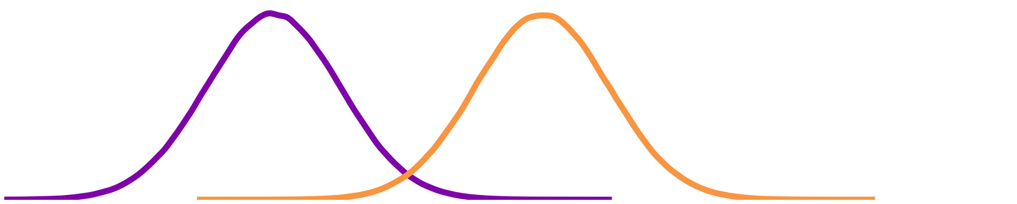

Key Findings: Temperature
Different
DRAM Cells
Vulnerability to Read Disturbance
Temperature
DRAM read disturbance is more effective within a bounded temperature range
Trap-Assisted Charge Leakage Model [Yang+, EDL’2019]
Hammering a wordline pulls and pushes electrons
Electrons get trapped and exacerbate charge leakage, leading to cause bitflips
With increasing temperature, it becomes less likely for an electron to get trapped
Vulnerable temperature range varies across cells
A DRAM cell should be tested at each possible operating temperature
Notes:
I will share two examples of many novel observations in these works. The first one is temperature. [CLICK]
We observe that DRAM read disturbance is more effective within a temperature range [CLICK]
Vulnerable temperature range varies across memory regions [CLICK]

Slide 19
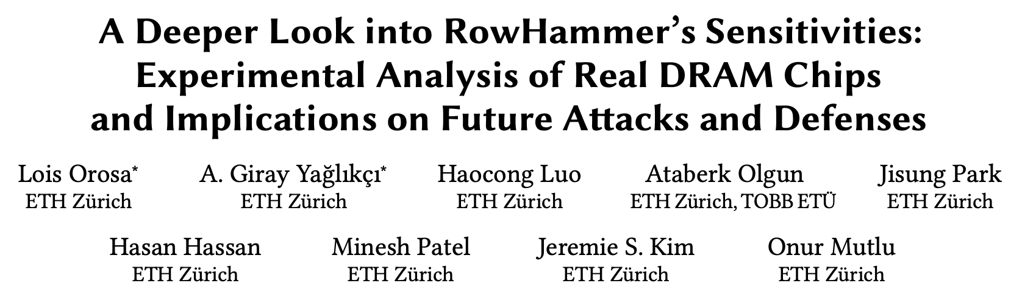
Contributions to Understanding RowHammer
Lois Orosa*, Abdullah Giray Yağlıkçı*, Haocong Luo, Ataberk Olgun, Jisung Park, Hasan Hassan, Minesh Patel, Jeremie S. Kim, and Onur Mutlu, "A Deeper Look into RowHammer’s Sensitivities: Experimental Analysis of Real DRAM Chips and Implications on Future Attacks and Defenses" Proceedings of the 54th International Symposium on Microarchitecture (MICRO), Virtual, October 2021. [Slides (pptx) (pdf)] [Talk Video (21 minutes)] [Short Talk Slides (pptx) (pdf)] [Lightning Talk Slides (pptx) (pdf)] [Lightning Talk Video (1.5 minutes)] [arXiv version]
Notes:
Our goal in this work is to Provide insights into three fundamental properties of RowHammer:
Temperature [CLICK]
Aggressor row active time [CLICK]
Victim DRAM cell's physical location [CLICK]
By doing so we aim enabling research to find effective and efficient attacks and defenses [CLICK]

Slide 20
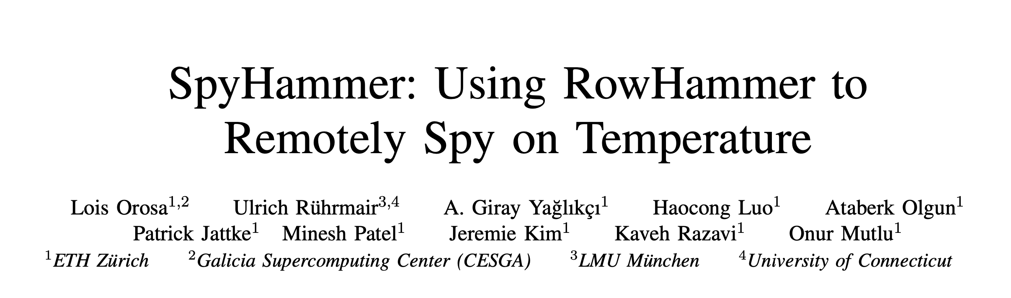
A Follow-Up Work: SpyHammer [Orosa+, arXiv’22]
https://arxiv.org/pdf/2210.04084.pdf

Slide 21
Our Recent Works
Temperature
Memory access patterns
Victim cell’s physical location
Leveraging
Heterogeneity
Notes:
I also developed solutions that [CLICK]
throttle unsafe accesses [CLICK
parallelize maintenance operations [CLICK]
and leverage heterogeneity [CLICK]
Let me quickly explain one of these works [CLICK]

Slide 22
Key Findings: Memory Access Patterns
Read disturbance is more effective
if the activated aggressor row stays active longer
Open
Open
Close
Close
State-of-the-Art
Our Finding
36% reduction
Minimum activation count to induce the first bitflip
Fewer reads cause a more significant read disturbance
when the activated aggressor row stays active longer
Existing mitigations are ineffective without this insight
Notes:
The second example is about the memory access patterns. [CLICK]
We observe that read disturbance is more effective if the read memory region stays active longer [CLICK]
And thus fewer reads cause bitflips[CLICK]

Slide 23
Contributions to Understanding RowHammer
Lois Orosa*, Abdullah Giray Yağlıkçı*, Haocong Luo, Ataberk Olgun, Jisung Park, Hasan Hassan, Minesh Patel, Jeremie S. Kim, and Onur Mutlu, "A Deeper Look into RowHammer’s Sensitivities: Experimental Analysis of Real DRAM Chips and Implications on Future Attacks and Defenses" Proceedings of the 54th International Symposium on Microarchitecture (MICRO), Virtual, October 2021. [Slides (pptx) (pdf)] [Talk Video (21 minutes)] [Short Talk Slides (pptx) (pdf)] [Lightning Talk Slides (pptx) (pdf)] [Lightning Talk Video (1.5 minutes)] [arXiv version]
Notes:
Our goal in this work is to Provide insights into three fundamental properties of RowHammer:
Temperature [CLICK]
Aggressor row active time [CLICK]
Victim DRAM cell's physical location [CLICK]
By doing so we aim enabling research to find effective and efficient attacks and defenses [CLICK]

Slide 24

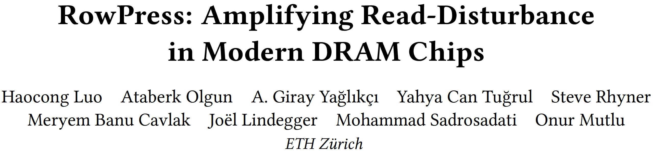
RowPress [Luo+, ISCA 2023] (Follow up of our analysis)
Haocong Luo, Ataberk Olgun, Giray Yaglikci, Yahya Can Tugrul, Steve Rhyner, M. Banu Cavlak, Joel Lindegger, Mohammad Sadrosadati, and Onur Mutlu, "RowPress: Amplifying Read Disturbance in Modern DRAM Chips" Proceedings of the 50th International Symposium on Computer Architecture (ISCA), Orlando, FL, USA, June 2023. [Slides (pptx) (pdf)] [Lightning Talk Slides (pptx) (pdf)] [Lightning Talk Video (3 min)] [RowPress Source Code and Datasets (Officially Artifact Evaluated with All Badges)] Best artifact award at ISCA 2023.
Keep rows active for 36ns: 47K activations are enough to induce bitflips
Keep rows active for 7.8us: 5K activations are enough to induce bitflips
Keep a row active for 30ms: 1 activation is enough to induce bitflips

Slide 25
Our Recent Works
Temperature
Memory access patterns
Victim cell’s physical location
Leveraging
Heterogeneity
Notes:
I also developed solutions that [CLICK]
throttle unsafe accesses [CLICK
parallelize maintenance operations [CLICK]
and leverage heterogeneity [CLICK]
Let me quickly explain one of these works [CLICK]

Slide 26
Variation in Read Disturbance Vulnerability Across DRAM Rows
To induce a read disturbance bitflip, one should access a row
Read disturbance solutions are configured for the worst row
Not all rows need the same level of protection
Read disturbance solutions incur large performance overheads due to overprotecting many rows
DRAM Rows
Spatial variation in read disturbance vulnerability
across DRAM rows
1-10K times
10K-100K times
>100K times

Slide 27
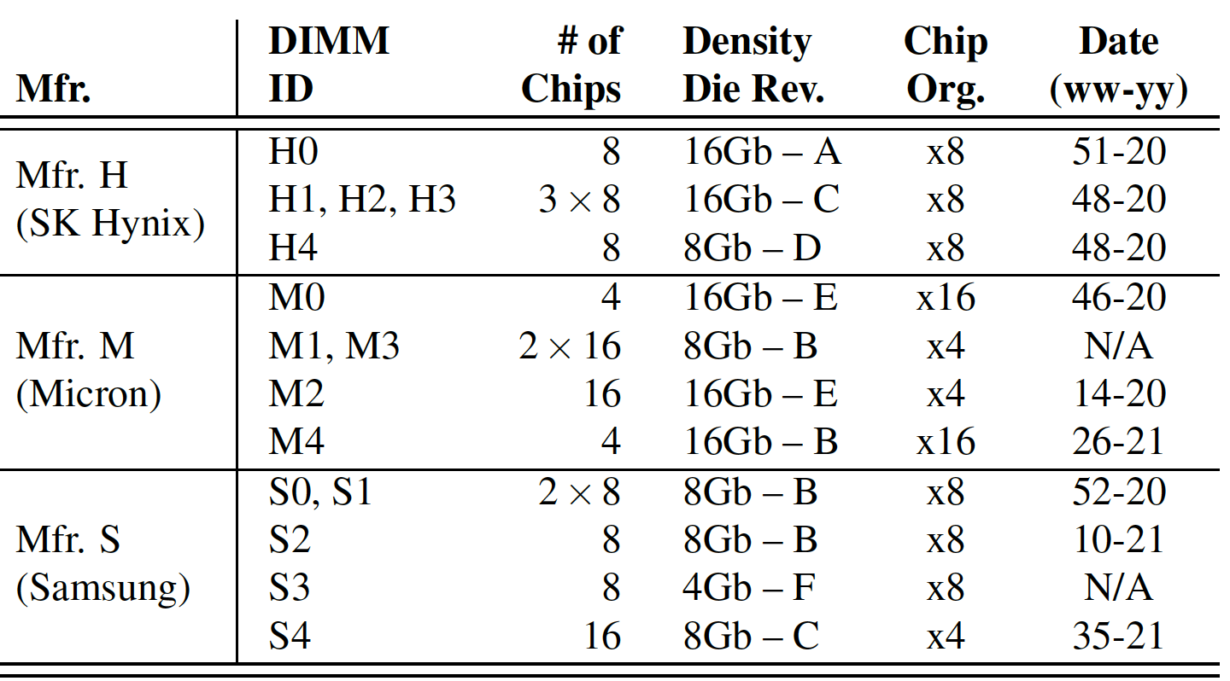
Tested DRAM Chips
144 DRAM chips from SK Hynix, Micron, and Samsung
Notes:
We test 144 DRAM chips [CLICK]
That implement various densities-die revisions [CLICK]
And chip organizations [CLICK]

Slide 28
Key Takeaway from Real Chip Experiments
Read disturbance vulnerability varies
significantly and irregularly across DRAM rows
Notes:
And show that there is a large variation in read disturbance across rows

Slide 29
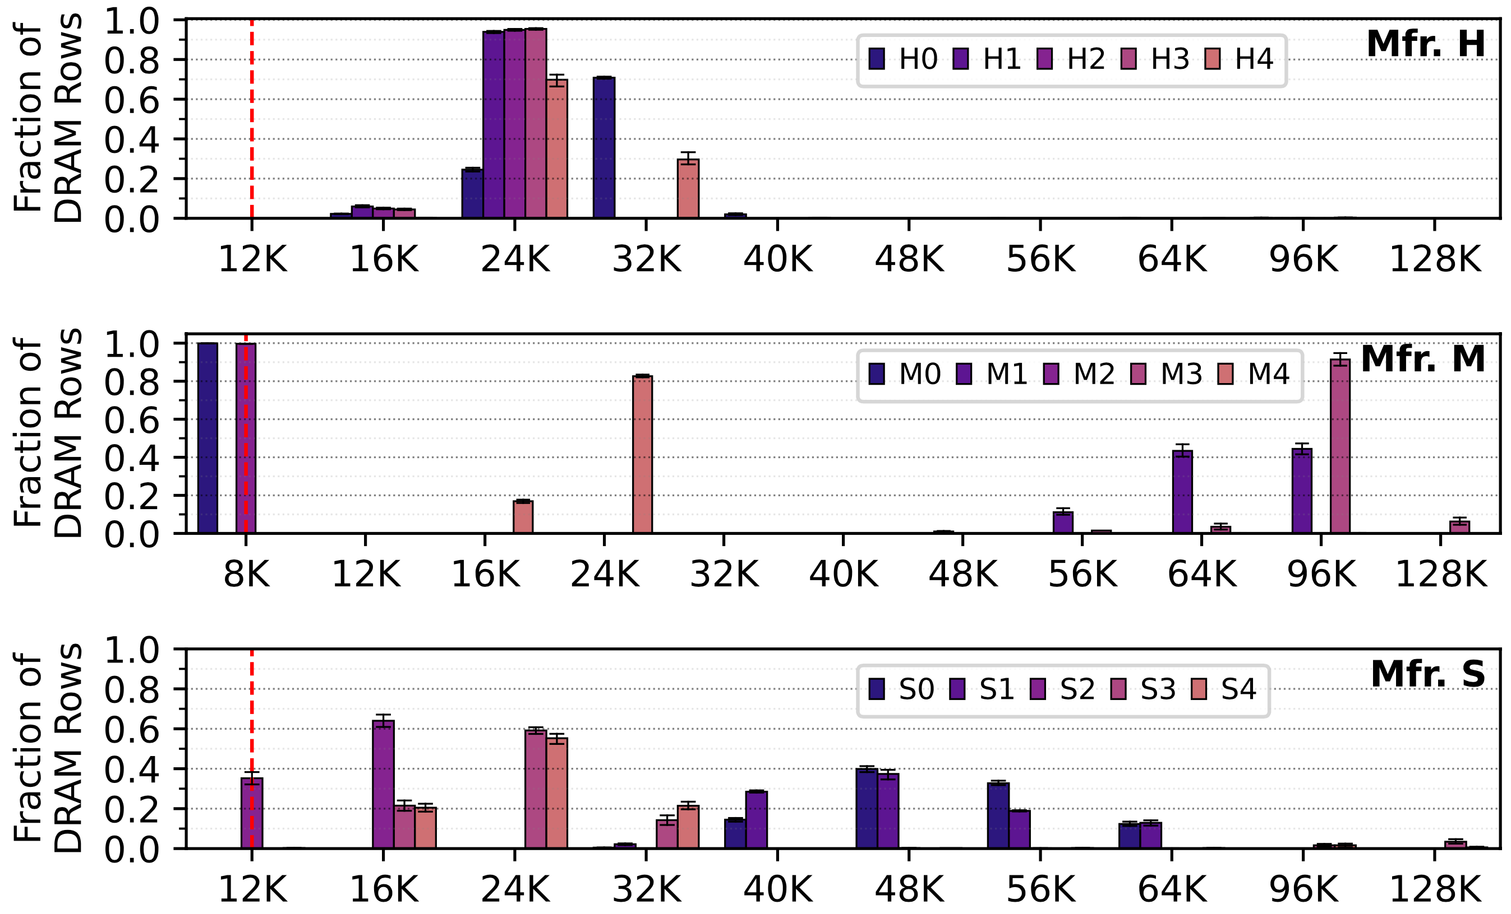
Spatial Variation in the Minimum Hammer Count to Induce the First Bitflip across DRAM Rows
Variation across banks
Different DRAM modules from Mfr. S
Fraction of DRAM Rows
Worst
HC_{first}
Minimum hammer count to induce the first bitflip (HC_{first})
S0
S1
S2
S3
S4
The minimum hammer count to induce the first bitflip
significantly varies across rows in a DRAM bank
Notes:
And show that there is a large variation in read disturbance across rows

Slide 30
Spatial Variation in the Minimum Hammer Count to Induce the First Bitflip across DRAM Rows
Fraction of DRAM Rows
Fraction of DRAM Rows
Fraction of DRAM Rows
Minimum hammer count to induce the first bitflip (HC_{first})

Slide 31
Spatial Variation in the Minimum Hammer Count to Induce the First Bitflip across DRAM Rows
The minimum hammer count to induce the first bitflip
significantly varies across rows in a DRAM bank
Minimum Hammer Count to Induce the First Bitflip (HC_{first})

Slide 32
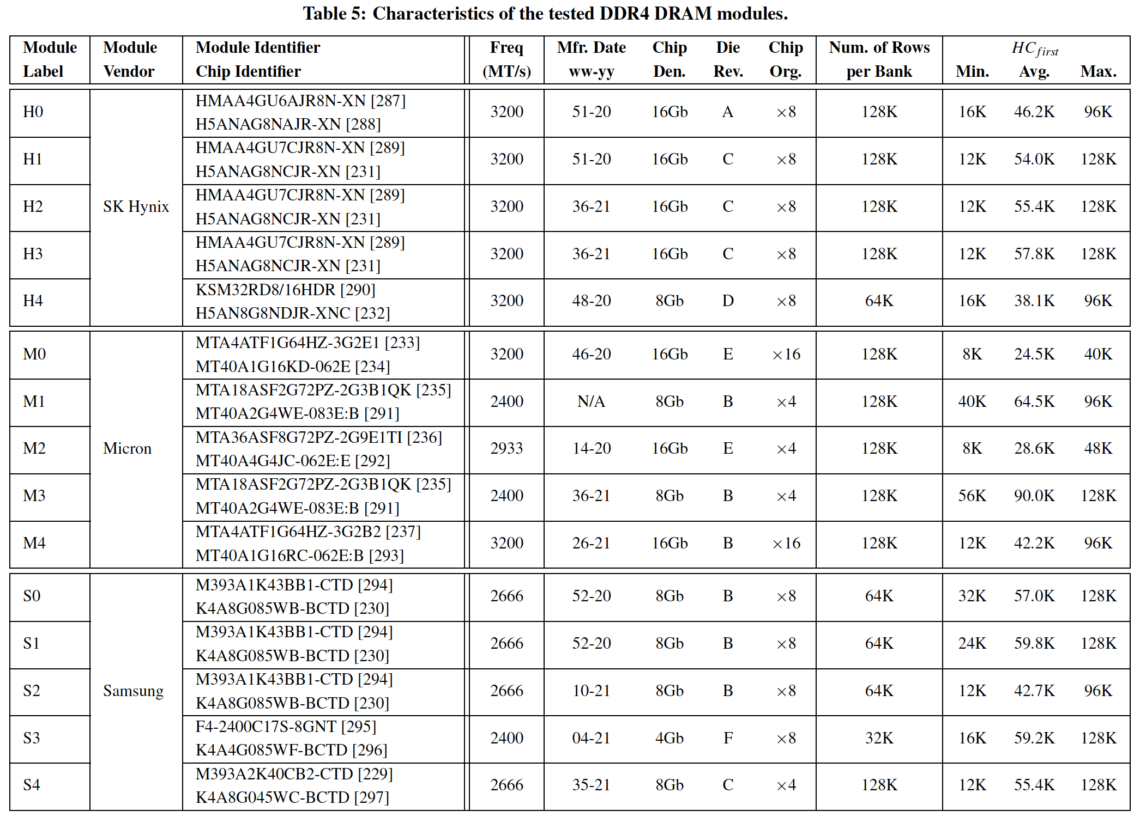
More Detailed Information in the Extended Version
https://arxiv.org/pdf/2402.18652.pdf

Slide 33
Our Recent Works
Temperature
Memory access patterns
Victim cell’s physical location
Leveraging
Heterogeneity
Notes:
I also developed solutions that [CLICK]
throttle unsafe accesses [CLICK
parallelize maintenance operations [CLICK]
and leverage heterogeneity [CLICK]
Let me quickly explain one of these works [CLICK]

Slide 34
Motivation
DRAM read disturbance worsens as DRAM chip density increases
Existing solutions become more aggressive
Overprotecting many rows significantly increases their performance overhead
Significant performance and energy overhead
Notes:
Quantify

Slide 35
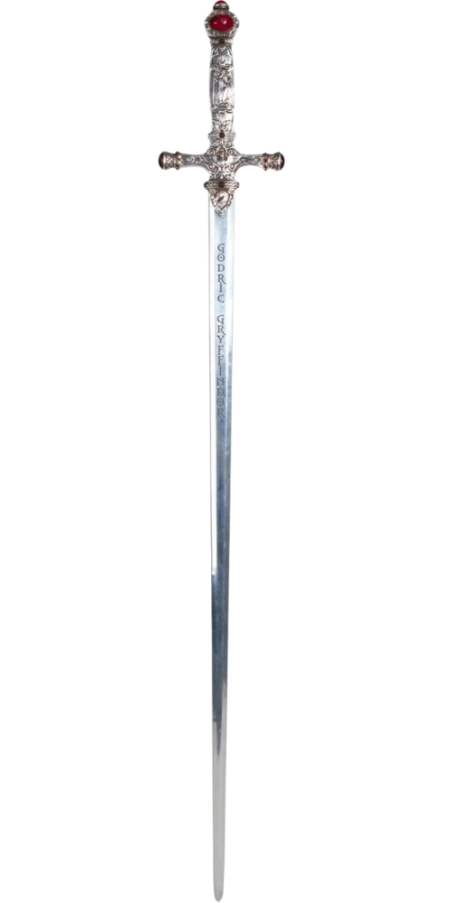
Svärd: Spatial Variation-Aware Read Disturbance Defenses
Dynamically tunes the aggressiveness of existing solutions to the victim row’s read disturbance vulnerability
Svärd performs fewer preventive actions (e.g., refresh) for rows that are less vulnerable to read disturbance
Svärd performs more preventive actions (e.g., refresh) for rows that are more vulnerable to read disturbance
Svärd significantly reduces the performance overhead of existing solutions
Svärd is Swedish for sword, a weapon with a long blade for cutting or thrusting [Merriam-Webster]
Notes:
We leverage this observation [CLICK]
By protecting weak rows more aggressively than strong rows [CLICK]
We do this by dynamically tuning the aggressiveness of defense mechanisms [CLICK]
and we show significant improvement in system performance. [CLICK]

Slide 36
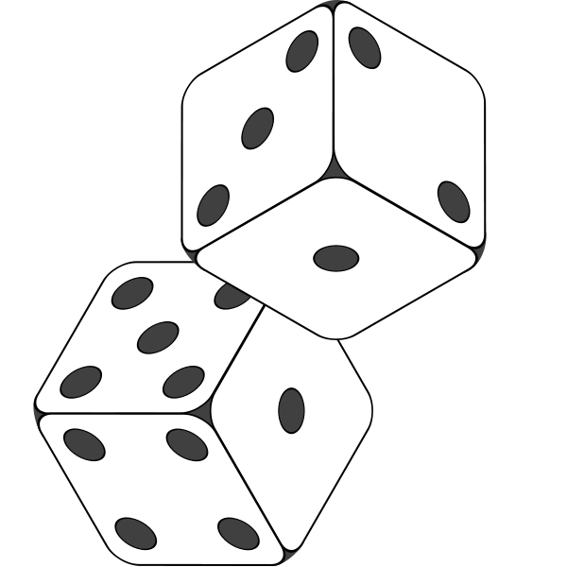
Svärd: Integration with Existing Read Disturbance Solutions
PARA: Probabilistic Row Activation [Kim+, ISCA’14]
Random
Number
Yes
Preventively
refresh the victim row
Row
Activation
>
Threshold
>
Threshold
victim row
Less vulnerable
Svärd
Higher threshold
→ Fewer refresh
More vulnerable
Lower threshold
→ More aggressive refresh
Svärd dynamically tunes PARA’s threshold to the victim row’s vulnerability
Svärd works with many read disturbance solutions, including:
BlockHammer [Yaglikci+, HPCA’21]
Hydra [Qureshi+, ISCA’22]
RRS [Saileshwar+, ASPLOS’22]
AQUA [Saxena+, MICRO’22]

Slide 37
Svärd: Metadata Management
Classifies DRAM rows into several vulnerability bins
Maintains a few (e.g., four) bits per DRAM row
Implemented where the read disturbance solution is
Memory controller-based implementation:
Metadata can be maintained in
SRAM table in the memory controller
Data integrity bits in the DRAM chip
…
In-DRAM implementation:
Metadata can be maintained in
DRAM rows
Separate DRAM array
…

Slide 38
Performance Evaluation
Cycle-level simulations using Ramulator 2.0 [Luo+, CAL 2023] https://github.com/CMU-SAFARI/ramulator2
System Configuration:
Workloads: 120 different 8-core multiprogrammed workloads from SPEC CPU2006, SPEC CPU2017, TPC, MediaBench, and YCSB benchmark suites
Integrated with AQUA, BlockHammer, PARA, Hydra, and RRS
HC_{first}: {4K, 2K, 1K, 512, 256, 128, 64} hammers Minimum hammer count needed to induce the first bitflip
Processor | 3.2 GHz, 8 core, 4-wide issue, 128-entry instr. window
Last-Level Cache | 64-byte cache line, 8-way set-associative, 8 MB
Memory Scheduler | FR-FCFS
Address Mapping | Minimalistic Open Pages
Main Memory | DDR4, 4 bank group, 4 banks per bank group (16 banks per rank)
Notes:
We use Ramulator for cycle-level simulations in our performance evaluation [CLICK]
We simulate a realistic system with the shown parameters that I will not explain in detail [CLICK]
We simulate 125 different 8-core multiprogrammed workloads [CLICK]
We sweep DRAM chip capacity from 2Gb to 128Gb [CLICK]
And RowHammer threshold: the minimum number of activations needed to induce the first RowHammer bit flip from 1K to 64 [CLICK]

Slide 39
Implications on Future Solutions
PARA
Reduction in Performance Overhead
Weighted Speedup
(Norm. to No Mitigation Baseline)
1.95x
Speedup
Evaluated for three different vulnerability profiles gathered from real DRAM modules
Minimum Hammer Count to Induce the First Bitflip

Slide 40
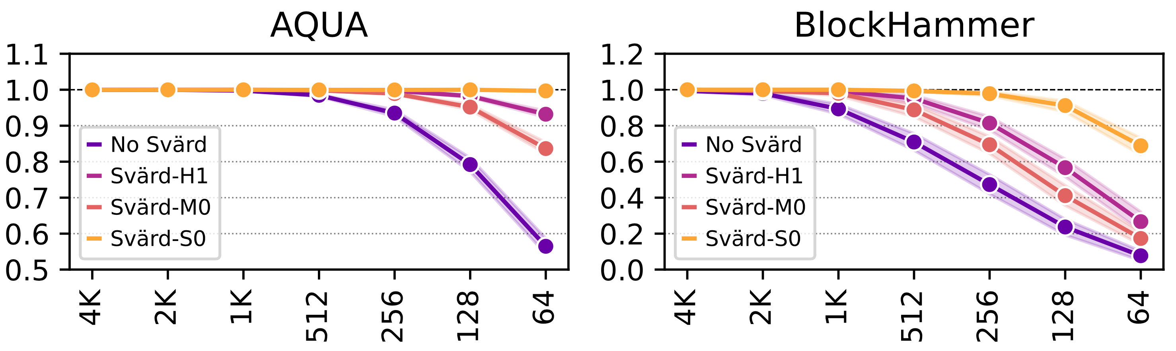
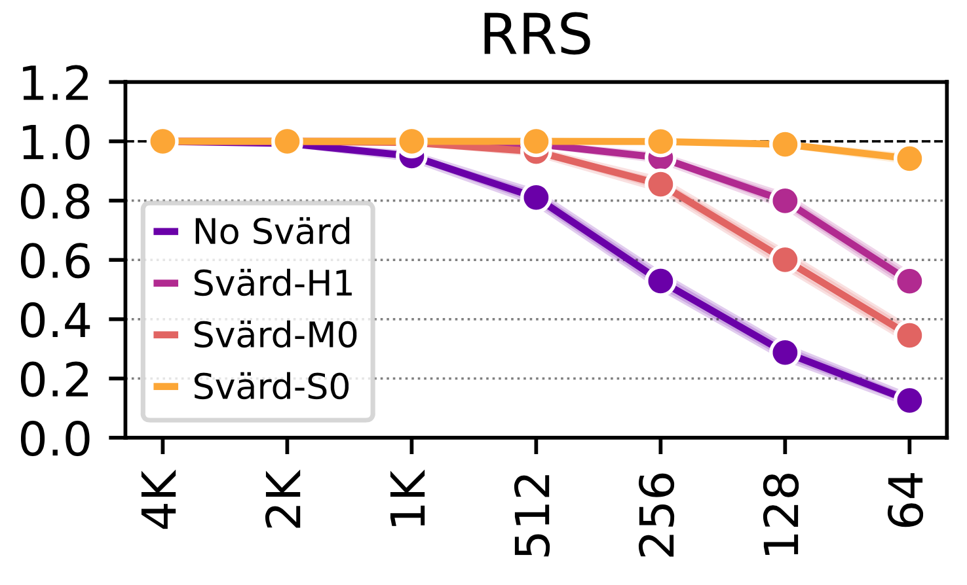
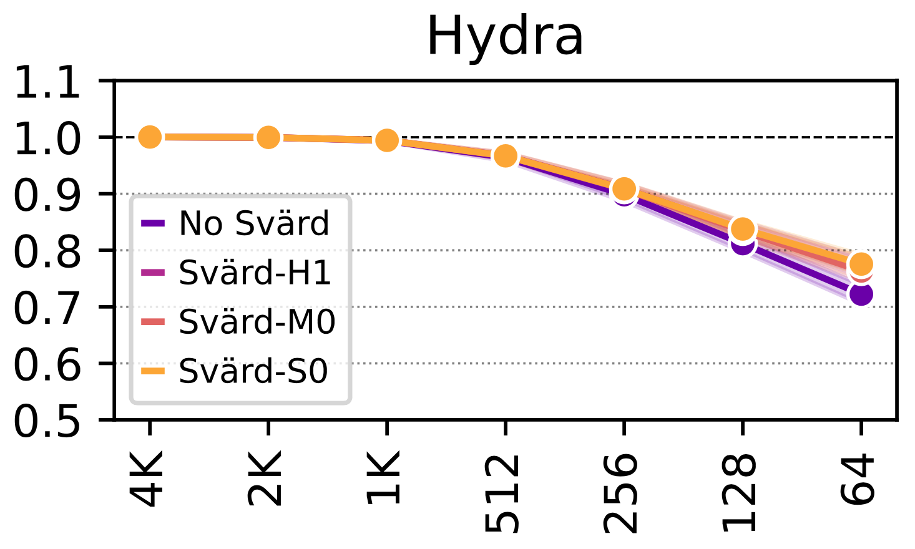
Implications on Future Solutions
Weighted Speedup
(Norm. to No Mitigation Baseline)
Minimum Hammer Count to Induce the First Bitflip

Slide 41
Implications on Future Solutions
1.63x Speedup
4.88x Speedup
Svärd significantly reduces the performance overhead of existing solutions
Weighted Speedup
(Norm. to No Mitigation Baseline)
4.80x Speedup
1.07x Speedup
Minimum Hammer Count to Induce the First Bitflip

Slide 42
Spatial Variation-Aware Read Disturbance Defenses
The first rigorous experimental study on the spatial variation of DRAM read disturbance across DRAM rows
144 DDR4 DRAM chips from three major manufacturers
Characterize all rows in a bank and four banks in a DRAM chip
Svärd: Spatial Variation-Aware Read Disturbance Defenses
Dynamically tunes a solution’s aggressiveness (e.g., perform more/less refresh) to the victim row’s vulnerability to DRAM read disturbance
Implemented either in the memory controller or in the DRAM chip
Read disturbance vulnerability varies significantly and irregularly across DRAM rows
Svärd significantly reduces the performance overhead of existing solutions
..

Slide 43
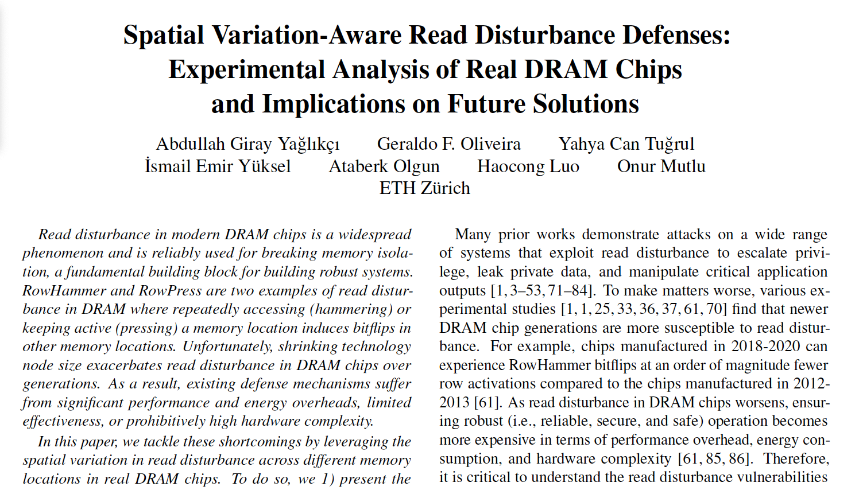
Enabling Efficient and Scalable Solutions
Spatial variation in read disturbance bit error rate across rows
Spatial variation of RowPress across DRAM rows
Algorithms and details of our experiments
Reverse-engineering of subarray boundaries
Hardware Complexity Analysis
Chip area cost
Either 0.43% of a processor die per DRAM rank with 16 banks in the memory contr.
0.006% increase in the DRAM array (4 bits / 8KB)
No additional latency overhead
A preliminary analysis of the effect of aging on DRAM read disturbance vulnerability
https://arxiv.org/pdf/2402.18652.pdf

Slide 44
Our Recent Works
Temperature
Memory access patterns
Victim cell’s physical location
Leveraging
Heterogeneity
Notes:
I also developed solutions that [CLICK]
throttle unsafe accesses [CLICK
parallelize maintenance operations [CLICK]
and leverage heterogeneity [CLICK]
Let me quickly explain one of these works [CLICK]

Slide 45
My Dissertation Works
A deeper look into DRAM read disturbance
Solutions to DRAM read disturbance
Temperature
Memory access patterns
Victim cell’s physical location
Voltage
Leveraging
Heterogeneity
Throttling Unsafe Accesses
Parallelizing Preventive Actions
Notes:
I also developed solutions that [CLICK]
throttle unsafe accesses [CLICK
parallelize maintenance operations [CLICK]
and leverage heterogeneity [CLICK]
Let me quickly explain one of these works [CLICK]

Slide 46


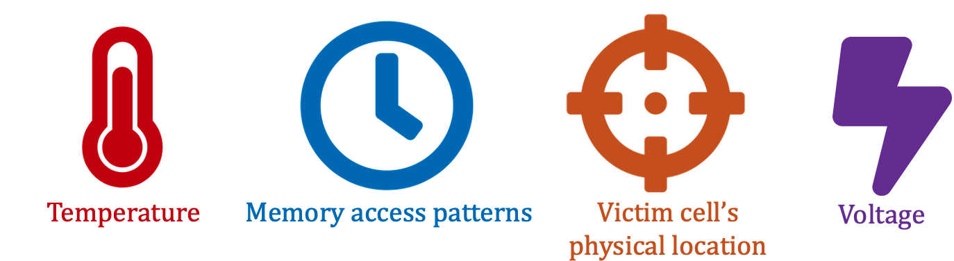


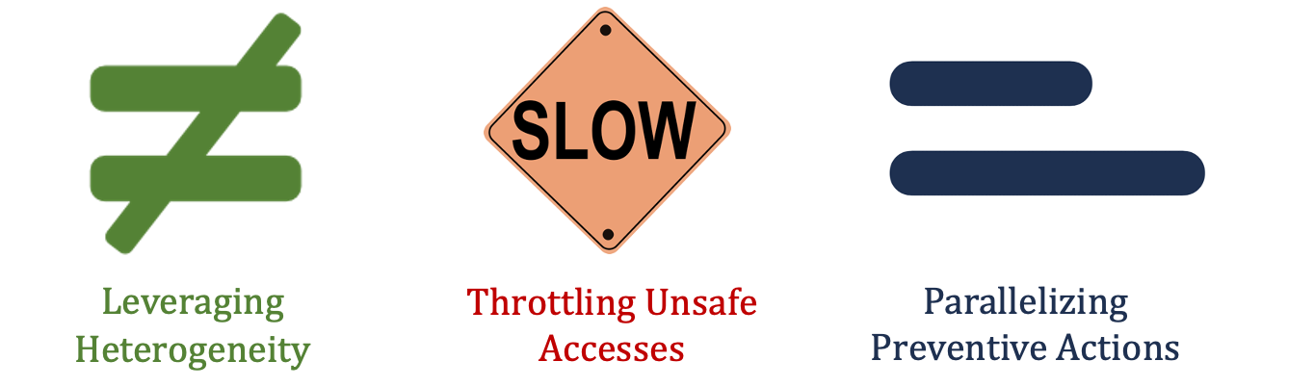
More Details and Discussion on YouTube
https://www.youtube.com/live/CRtm1es4n3o?si=8N5zB6e_RUc5Ejl8
https://www.youtube.com/live/YQwRYWpCsk0?si=jXPueMHb5wgs69-q

Slide 47
Enabling Efficient and Scalable Read Disturbance Mitigation via New Experimental Insights into Modern Memory Chips
Abdullah Giray Yaglikci
agyaglikci@gmail.com
https://agyaglikci.github.io
13 March 2024
Microsoft, Cambridge
agyaglikci.github.io
safari.ethz.ch
Notes:
Hi my name is Giray and I am happy to share my research with you

Slide 48
Enabling Efficient and Scalable Read Disturbance Mitigation via New Experimental Insights into Modern Memory Chips
Current and Future Work Discussion
Abdullah Giray Yaglikci
agyaglikci@gmail.com
https://agyaglikci.github.io
agyaglikci.github.io
safari.ethz.ch
Notes:
Hi my name is Giray and I am happy to share my research with you

Slide 49
Current and Future Challenges

Reliability

Performance

Fairness
●
Energy
Efficiency
While the memory systems
scale-up and are shared across many users (e.g., disaggregated memory systems)
scale-down in manufacturing technology node size
support processing near/using memory
Notes:
Going forward, we need to address [CLICK]
reliability [CLICK]
Performance [CLICK
Fairness [CLIKC]
And energy efficiency challenges [CLICK]
While memory systems
[CLICK] scale up and shared
[CLICK] scale down in technology node size
[CLICK and support processing near/using memory

Slide 50
Future Research for Better Memory Systems

Deeper Understanding of
Physics and Vulnerabilities

Flexible and Intelligent Memory Chips, Interfaces, Controllers

Cross-Layer
Communication
Notes:
We can address these challenges by investing on [CLICK]
Better cross-layer communication[CLICK]
More intelligent memory chips, interfaces, and controllers [CLICK]
And deeper understanding of physics and vulnerabilities [CLICK]

Slide 51
Deeper Understanding of Physics and Vulnerabilities
The effect of aging Preliminary data on aging via 68-day of continuous hammering
Aging can lead to read disturbance bitflips at smaller hammer counts
Minimum hammer count to induce the first bitflip HC_{first} (after aging)
Minimum hammer count to induce the first bitflip HC_{first} (after aging)
Minimum hammer count to induce the first bitflip HC_{first} (before aging)
Minimum hammer count to induce the first bitflip HC_{first} (before aging)
51

Slide 52
Deeper Understanding of Physics and Vulnerabilities
The effect of aging Preliminary data on aging via 68-day of continuous hammering
Aging can lead to read disturbance bitflips at smaller hammer counts
Minimum hammer count to induce the first bitflip HC_{first} (after aging)
Minimum hammer count to induce the first bitflip HC_{first} (after aging)
Future work:
rigorous aging characterization
and online profiling of read disturbance vulnerability
Minimum hammer count to induce the first bitflip HC_{first} (before aging)
Minimum hammer count to induce the first bitflip HC_{first} (before aging)
52

Slide 53
Deeper Understanding of Physics and Vulnerabilities
The effect of aging
Interactions across different error mechanisms
RowHammer
RowPress
Data retention time errors
Variable retention time
…

Slide 54
Deeper Understanding of Physics and Vulnerabilities
The effect of aging
Interactions across different error mechanisms
What is the worst-case?
Temperature
Data pattern
Memory access pattern
Spatial variation
Voltage
What is the worst-case considering all these sensitivities?
What is the minimum hammer count to induce a read disturbance bitflip?

Slide 55
Deeper Understanding of Physics and Vulnerabilities
The effect of aging
Interactions across different error mechanisms
What is the worst-case?
How reliable are our DRAM chips?
How reliable will our DRAM chips be tomorrow?
We do not know! This is an open research problem

Slide 56
Future Research for Better Memory Systems

Deeper Understanding of
Physics and Vulnerabilities

Flexible and Intelligent Memory Chips, Interfaces, Controllers

Cross-Layer
Communication
Notes:
We can address these challenges by investing on [CLICK]
Better cross-layer communication[CLICK]
More intelligent memory chips, interfaces, and controllers [CLICK]
And deeper understanding of physics and vulnerabilities [CLICK]

Slide 57
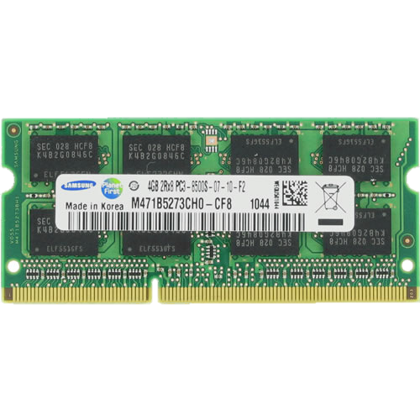
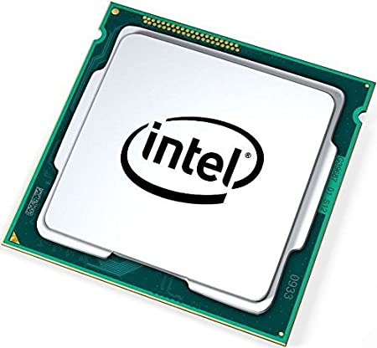
Flexible and Intelligent Chips, Interfaces, Controllers
In-field patching is necessary
DRAM read disturbance solution is here
Configuration
DRAM chip is here
DRAM module can be replaced
Reconfiguration is needed
+ add more hardware counters
+ increase metadata cache capacity
Aging might change the chip’s characteristics
Deployed solutions should be patchable in field

Slide 58
Flexible and Intelligent Chips, Interfaces, Controllers
In-field patching is necessary
Interfaces should be more flexible
Memory controller decides what should be done when
DRAM chip has read disturbance solution inside (tracking+prevention)
The memory controller should provide the DRAM chip with necessary time window to perform preventive actions (e.g., refreshing rows)
The memory controller does not have the tracking information
Communicating is not straightforward due to strict communication protocol
A more flexible interface is necessary

Slide 59
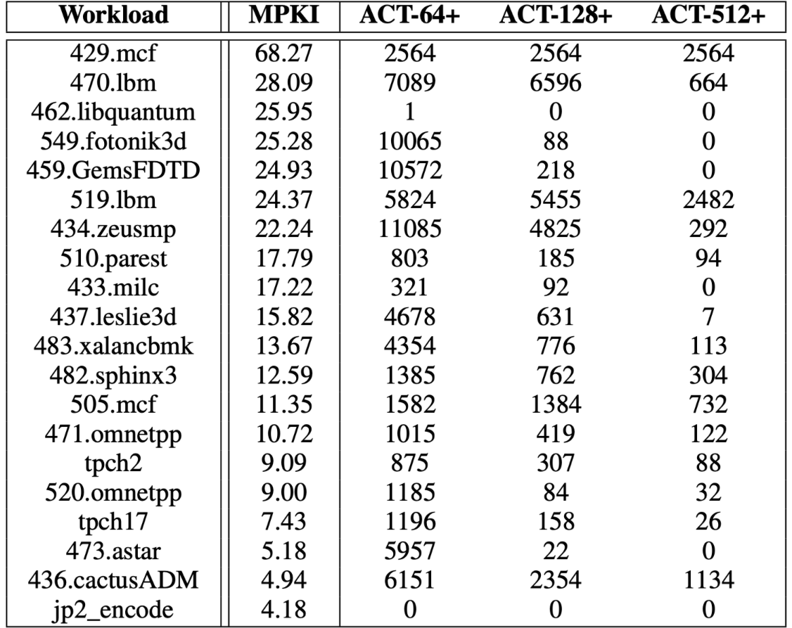
How Large is 1000 Activations?
Bitflips occur at ~1000 activations
Mitigation mechanisms trigger preventive actions (e.g., preventive refresh) at ~500 activations
Is 500 a distinctive activation count?
Benign workloads activate hundreds of rows more than 500 times in a refresh window
Memory intensive workloads from SPEC’06, SPEC’17, TPC, YCSB, and MediaBench
Benign workloads might not be so benign

Slide 60
Flexible and Intelligent Chips, Interfaces, Controllers
In-field patching is necessary
Interfaces should be more flexible
Memory controllers should be more intelligent in detecting malicious activity
DRAM chips become more and more vulnerable to RowHammer and RowPress
Key Insight:
A thousand activations are enough to induce bitflips
Benign applications perform as many activations
Problem: DRAM read disturbance solutions are getting prohibitively expensive
Research Question: How to identify malicious threads/processes/users?
More intelligent detection mechanisms are needed → AI can play an important role
The memory controller observes all memory accesses → has the ground truth data
More intelligent memory controllers can help

Slide 61
Future Research for Better Memory Systems

Deeper Understanding of
Physics and Vulnerabilities

Flexible and Intelligent Memory Chips, Interfaces, Controllers

Cross-Layer
Communication
Notes:
We can address these challenges by investing on [CLICK]
Better cross-layer communication[CLICK]
More intelligent memory chips, interfaces, and controllers [CLICK]
And deeper understanding of physics and vulnerabilities [CLICK]

Slide 62


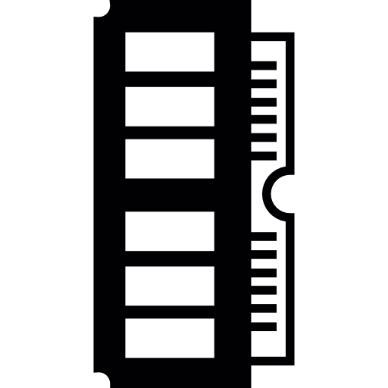
Cross-Layer Communication
Detection
Mitigation
Attacker is often an application
Bitflips occur in the circuit level
Hardware is good at
Detecting an attack
Performing counter-measures
Memory allocations
Memory access patterns
Control flow patterns
Time / power measurements
Software
Problem
Algorithm
Memory request scheduling
Speculative execution
Prefetching, branch prediction
Power management
Program/Language
System Software
uArch
SW/HW Interface
~
Micro-architecture
Logic
Devices
Bitflips occur
Memory isolation is broken
Electrons
Device
Notes:
We can address these challenges by investing on [CLICK]
Better cross-layer communication[CLICK]
More intelligent memory chips, interfaces, and controllers [CLICK]
And deeper understanding of physics and vulnerabilities [CLICK]

Slide 63
Cross-Layer Communication
Detection
Mitigation
Attacker is often an application
Bitflips occur in the circuit level
Hardware is good at
Detecting an attack
Performing counter-measures
Memory allocations
Memory access patterns
Control flow patterns
Time / power measurements
Software
Problem
Algorithm
Memory request scheduling
Speculative execution
Prefetching, branch prediction
Power management
Program/Language
Cross-layer communication is crucial going forward
System Software
uArch
SW/HW Interface
~
Micro-architecture
Logic
Devices
Bitflips occur
Memory isolation is broken
Electrons
Device
Notes:
We can address these challenges by investing on [CLICK]
Better cross-layer communication[CLICK]
More intelligent memory chips, interfaces, and controllers [CLICK]
And deeper understanding of physics and vulnerabilities [CLICK]

Slide 64
Future Research for Better Memory Systems

Deeper Understanding of
Physics and Vulnerabilities

Flexible and Intelligent Memory Chips, Interfaces, Controllers

Cross-Layer
Communication
Notes:
We can address these challenges by investing on [CLICK]
Better cross-layer communication[CLICK]
More intelligent memory chips, interfaces, and controllers [CLICK]
And deeper understanding of physics and vulnerabilities [CLICK]

Slide 65
Enabling Efficient and Scalable Read Disturbance Mitigation via New Experimental Insights into Modern Memory Chips
Backup Slides
Abdullah Giray Yaglikci
agyaglikci@gmail.com
https://agyaglikci.github.io
agyaglikci.github.io
safari.ethz.ch
Notes:
Hi my name is Giray and I am happy to share my research with you

Slide 66
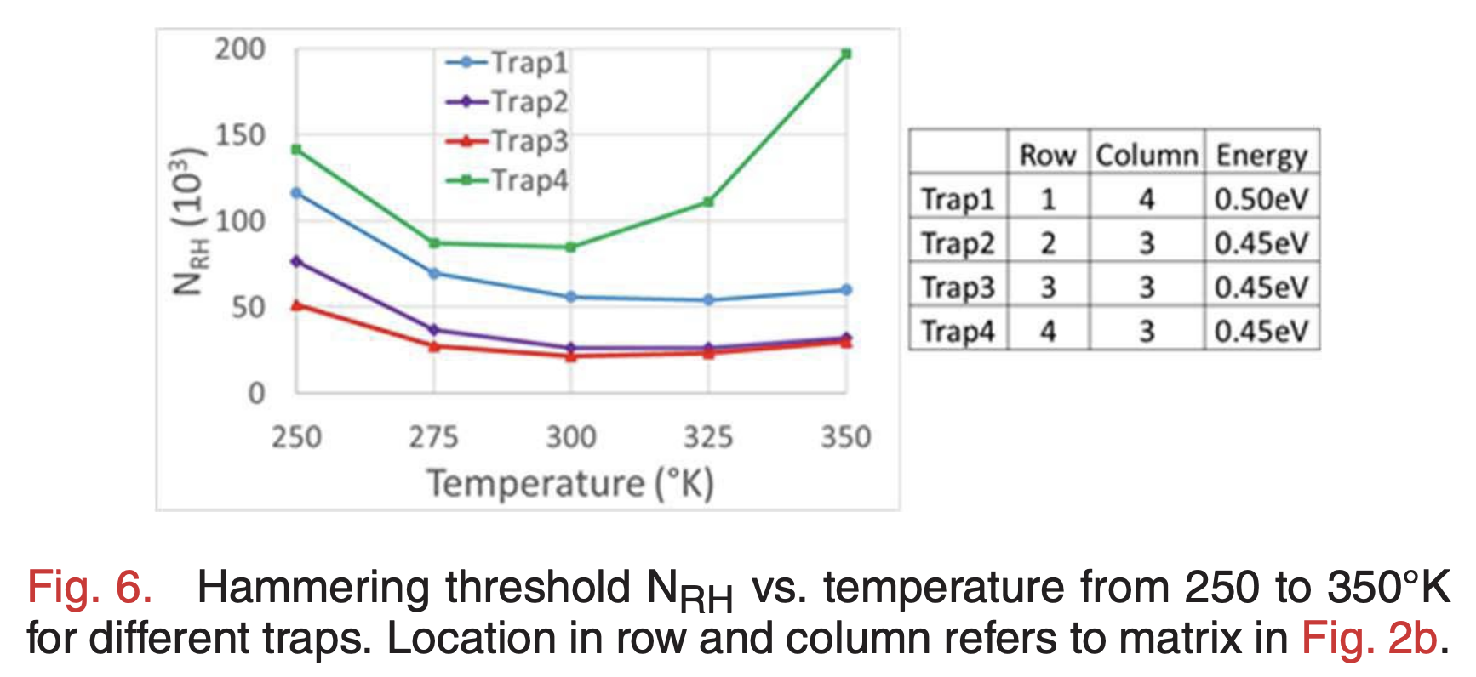
Circuit-Level Justification
Trap-Assisted Charge Leakage Model
Hammering a wordline pulls and pushes electrons
Electrons get trapped and exacerbate charge leakage, leading to cause bitflips
With increasing temperature, it becomes less likely for an electron to get trapped
3D TCAD Evaluation [Yang+, EDL'19]
Until a temperature inflection point: As temperature increases, fewer activations can cause bitflips
After the temperature inflection point:
As temperature increases, more activations are needed to cause bitflips
Notes:
And third, [CLICK]
We observe thatThe HCfirst change tends to be larger as temperature change increases [CLICK]
The figure shows that, for all manufacturer, when increase the temperature change from 50-55C to 50-90C, the absolute changes values increase [CLICK]

Slide 67
Example Attack Improvement: Bypassing Defenses with Aggressor Row Active Time
Activating aggressor rows as frequently as possible:
Row A is active
Row B is active
Row A is active
Time
Keeping the aggressor rows active for a longer time:
Row A is active
Row B is active
36% reduction in HC_{first}
Time
Reduces the minimum activation count to induce a bitflip by 36%
Bypasses defenses that do not account for this reduction
Notes:
In the third example, an attacker can leverage the effect of aggressor row active time [CLICK]
In this scenario, instead of activating aggressor rows as frequently as possible, [CLICK]
the attacker can keep the aggressor rows active for longer time [CLICK]
Based on our analyses, HCfirst reduces by 36% on average with the proposed access pattern
With this reduction, an attacker can bypass RowHammer defenses that do not account for this reduction [CLICK]

Slide 68
RowPress vs. RowHammer
Instead of using a high activation count,
☞ increase the time that the aggressor row stays open
RowHammer
Aggressor Row
Open
Close
36ns, 47K activations to induce bitflips
RowPress
Aggressor Row
Open
Close
7.8µs, only 5K activations to induce bitflips
We observe bitflips even with ONLY ONE activation in extreme cases where the row stays open for 30ms
Notes:
Instead of a high activation count, RowPress increases the time the that aggressor stays open.
Doing disturbs adjacent rows enough to cause bitflips without a very high activation count.
We observe bitflips even with only one activation in extreme cases.

Slide 69
RowPress [Luo+, ISCA 2023]
Haocong Luo, Ataberk Olgun, Giray Yaglikci, Yahya Can Tugrul, Steve Rhyner, M. Banu Cavlak, Joel Lindegger, Mohammad Sadrosadati, and Onur Mutlu, "RowPress: Amplifying Read Disturbance in Modern DRAM Chips" Proceedings of the 50th International Symposium on Computer Architecture (ISCA), Orlando, FL, USA, June 2023. [Slides (pptx) (pdf)] [Lightning Talk Slides (pptx) (pdf)] [Lightning Talk Video (3 minutes)] [RowPress Source Code and Datasets (Officially Artifact Evaluated with All Badges)] Officially artifact evaluated as available, reusable and reproducible. Best artifact award at ISCA 2023.

Slide 70
Circuit-Level Justification
We hypothesize that our observations are caused by the non-monotonic behavior of charge trapping characteristics of DRAM cells
3D TCAD model [Yang+, EDL'19]
HC_{first} decreases as temperature increases, until a temperature inflection point where HC_{first} starts to increase as temperature increases
A cell is more vulnerable to RowHammer at temperatures close to its temperature inflection point
Notes:
And third, [CLICK]
We observe thatThe HCfirst change tends to be larger as temperature change increases [CLICK]
The figure shows that, for all manufacturer, when increase the temperature change from 50-55C to 50-90C, the absolute changes values increase [CLICK]

Slide 71
Example Attack Improvement: Temperature-Dependent Trigger
Identify abnormal increase in temperature to attack a data center during its peak hours
Precisely measure the temperature to trigger an attack exactly at the desired temperature
1.
76.6%
of the cells*
70 °C
Temperature
2.
0.4%
of the cells*
0.4%
of the cells*
70 °C
70 °C
Temperature
Temperature
*Example fraction values from SK Hynix modules
Notes:
In the second attack example, the attacker uses RowHammer to understand the DRAM chip’s current temperature [CLICK]
As an example, more than 76% of the vulnerable cells experience bit flips above 70 degrees Celsius for Mfr C. Focusing on these cells, an attacker can identify abnormal operating conditions that might occur in a data center during its peak hours. This information can be used to trigger an attack when the data center is under pressure[CLICK]
If it is important to measure temperature precisely, the attacker can focus on a smaller set of vulnerable cells that experience bit flips only in a narrow temperature range. For example, 0.4% of vulnerable cells experience bit flips only at 70 degrees Celsius in Mfr C. Using these cells, the attacker can precisely detect the temperature and trigger an attack accordingly [CLICK]

Slide 72
Enabling Efficient and Scalable Read Disturbance Mitigation via New Experimental Insights into Modern Memory Chips
Backup Slides
Abdullah Giray Yaglikci
agyaglikci@gmail.com
https://agyaglikci.github.io
11 March 2024
Huawei Cambridge
agyaglikci.github.io
safari.ethz.ch
Notes:
Hi my name is Giray and I am happy to share my research with you

Slide 73
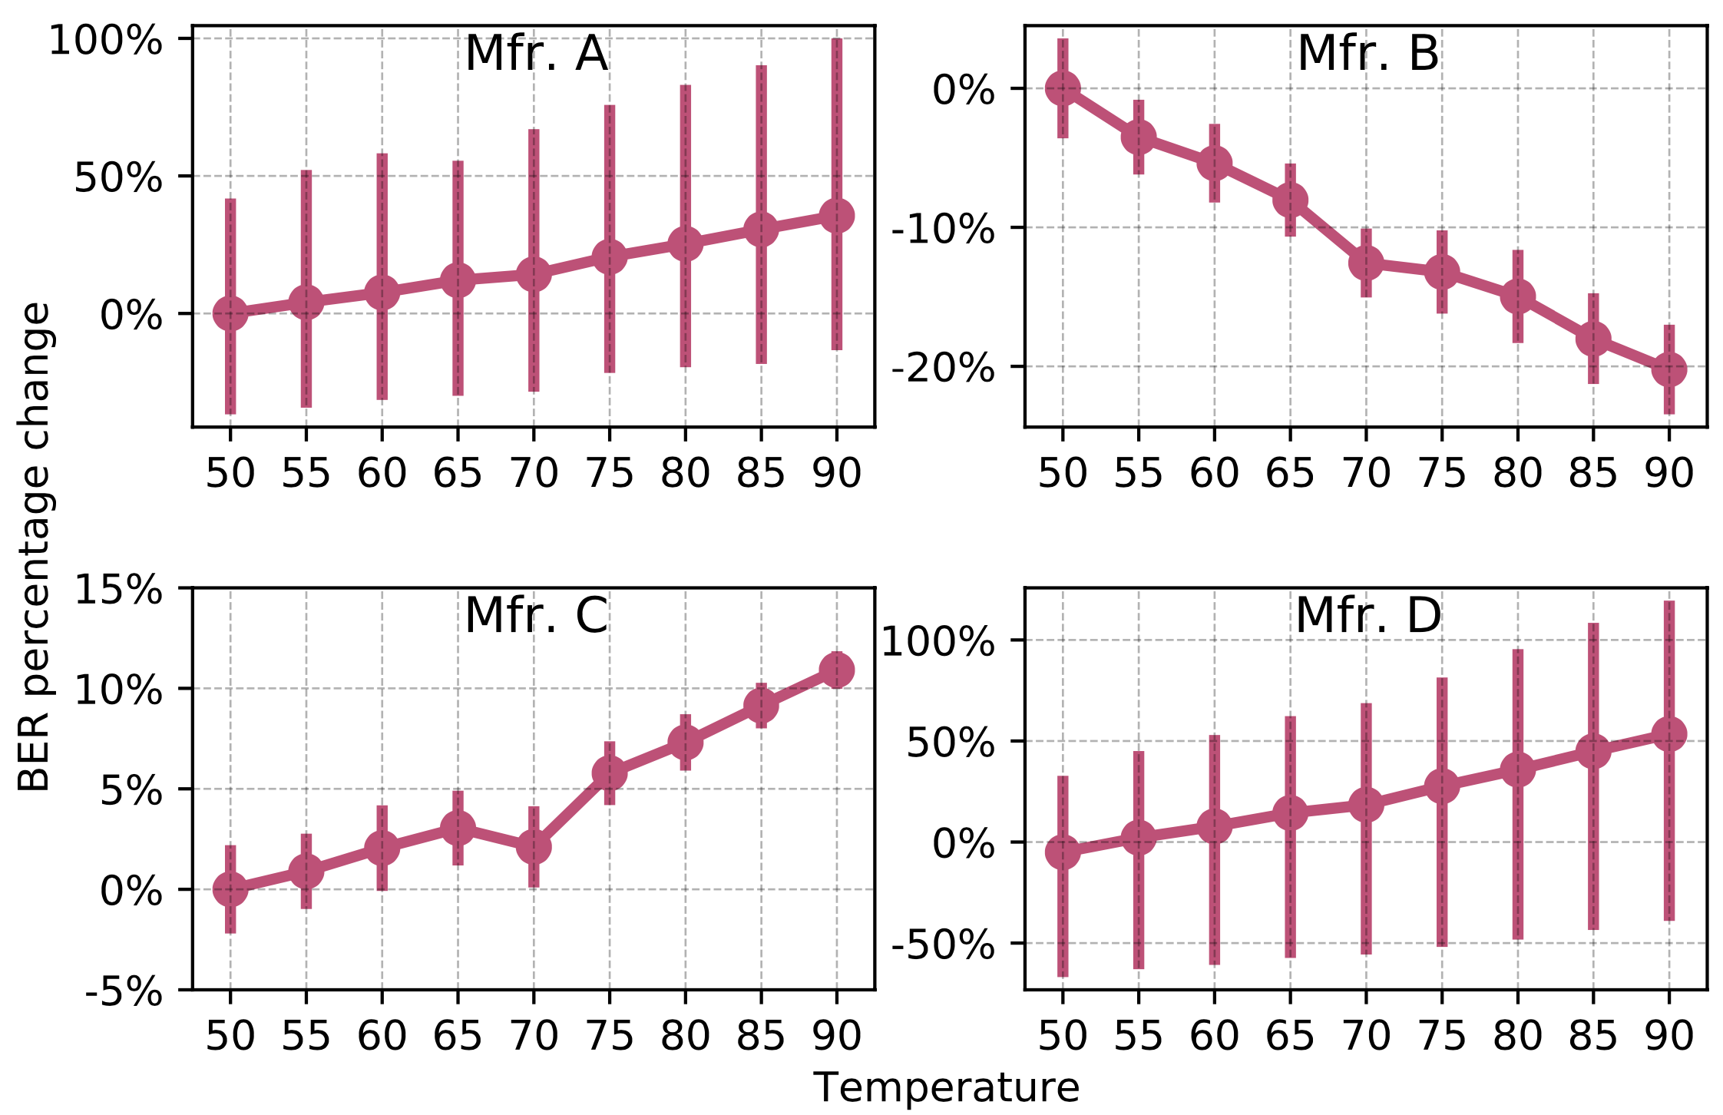
Impact of Temperature on DRAM Rows
Variation in Bit Flip Counts per DRAM Row
Temperature (°C)
OBSERVATION 4
A DRAM row’s bit error rate can either increase or decrease with temperature depending on the DRAM manufacturer
Notes:
We repeat this analysis for all four manufacturers [CLICK]
We observe that the bit error rate increases with temperature in modules from three manufacturers, [CLICK]
While it exhibits an opposite trend in modules from manufacturer B. We hypothesize that this happens due to different characteristics of charge trap error mechanisms in different manufacturers. Please refer to our full paper for more details [CLICK]
Our main observation from this figure is that A DRAM row’s BER can either increase or decrease with temperature depending on the DRAM manufacturer [CLICK]

Slide 74
Memory Access Patterns in Aggressor Row Active Time Analysis
Baseline access pattern:
Increasing aggressor row active time:
Increasing bank precharged time:
Row A is active
Row B is active
Row A is active
Row B is active
Time
Row A is active
Row B is active
Row A is active
Time
Aggressor row active time
Aggressor row active time
Aggressor row active time
Row A is active
Row B is active
Row A is active
Time
Bank precharged time
Bank precharged time
Bank precharged time
Notes:
To perform this analysis, we conduct two sets of experiments [CLICK]
In the baseline, we hammer rows A and B as frequently as possible [CLICK]
In the first set of tests, we increase the time that an aggressor row is active [CLICK],
And in the second set of experiments we increase the time that the bank is precharged [CLICK]

Slide 75
Thesis Statement
Developing
a deeper understanding of DRAM read disturbance and revisiting memory controller designs enable scientists and engineers to build reliable, secure, and safe DRAM-based systems
Notes:
My thesis is that Developing a deeper understanding of DRAM read disturbance and revisiting memory controller designs accordingly enable building reliable, safe, and secure systems. [CLICK]

Slide 76
DRAM Organization
Subarray
Bitline
DRAM Cell
Bank
Wordline
…
Chip I/O
. . .
DRAM Row
…
…
…
…
…
Row Buffer
DRAM Chip
DRAM Bank
DRAM Subarray
Notes:
This is a DRAM module, used as the main memory on many systems. [CLICK]
A DRAM module consists of multiple chips each of which contains multiple banks [CLICK]
Each bank is composed of multiple subarrays [CLICK]
And within each subarray, there is a two dimensional array of DRAM cells. [CLICK]
These cells are organized into rows that are selected using wordlines [CLICK]
And the cells are connected to a row buffer via bitlines [CLICK]

Slide 77
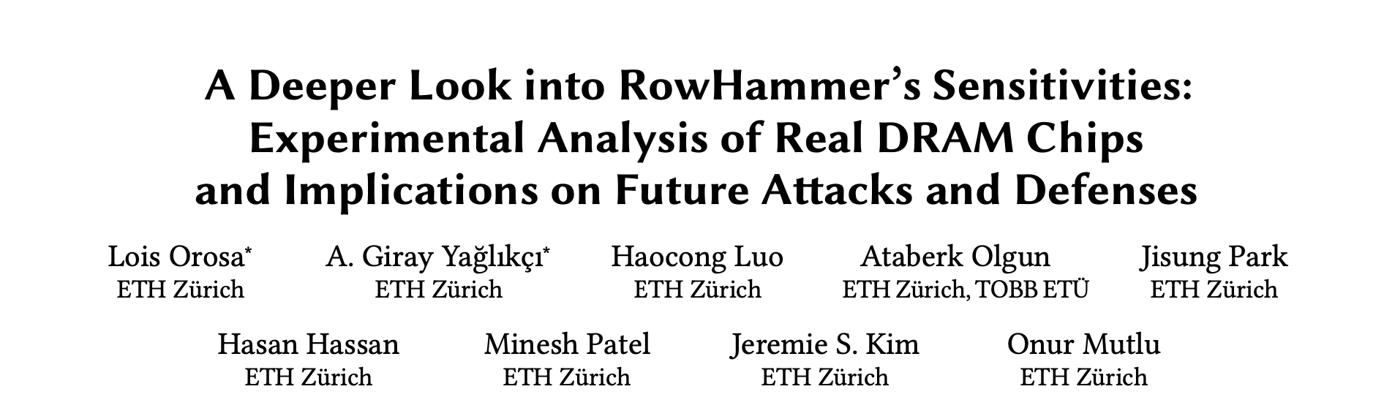
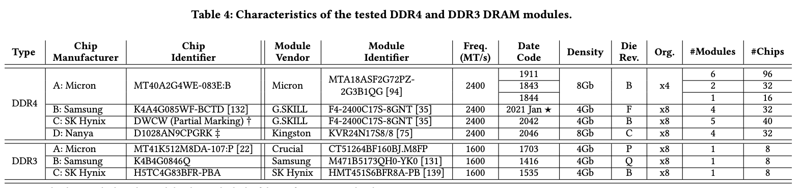
DRAM Chips Tested
Mfr. | DDR4 DIMMs | DDR3 SODIMMs | # Chips | Density | Die | Org.
A (Micron) | 9 | 1 | 144 (8) | 8Gb (4Gb) | B (P) | x4 (x8)
B (Samsung) | 4 | 1 | 32 (8) | 4Gb (4Gb) | F (Q) | x8 (x8)
C (SK Hynix) | 5 | 1 | 40 (8) | 4Gb (4Gb) | B (B) | x8 (x8)
D (Nanya) | 4 | - | 32 (-) | 8Gb (-) | C (-) | x8 (-)
272 total DRAM chips tested
Four major DRAM manufacturers
DDR3 and DDR4 DRAM standards
Different densities, die revisions and chip organizations
Notes:
We provide more details about the chips we test in extended arxiv version of the paper [CLICK]

Slide 78
DRAM Testing Methodology
To characterize our DRAM chips at worst-case conditions:
Prevent sources of interference during core test loop
No DRAM refresh: to avoid refreshing victim row
No DRAM calibration events: to minimize variation in test timing
No RowHammer mitigation mechanisms: to observe circuit-level effects
Test for less than a refresh window (32ms) to avoid retention failures
Repeat tests for ten times
Worst-case access sequence
We use worst-case access sequence based on prior works’ observations
For each row, repeatedly access the two physically-adjacent rows as fast as possible
Notes:
To characterize our DRAM chips at worst-case conditions we take two measures:
[CLICK] First, we prevent external sources of interference such that our tests can run consistently as desired and without interruptions. To achieve this we disable:
[CLICK] DRAM refresh to avoid refreshing victim rows during a test,
[CLICK] DRAM calibration events to minimize variation in test timings
[CLICK] and RowHammer mitigation mechanisms to ensure that we can directly observe circuit-level bit flips
[CLICK] we also ensure that our RowHammer tests complete in less than a refresh window to prevent retention failures from interfering with our results
[CLICK] and we repeat our tests ten times to filter out the noise in measurements
[CLICK] Second, we issue the worst-case access sequence for inducing RowHammer bit flips based on observations from prior work
[CLICK] which suggest to repeatedly activate the two physically-adjacent rows as fast as possible
=========

Slide 79
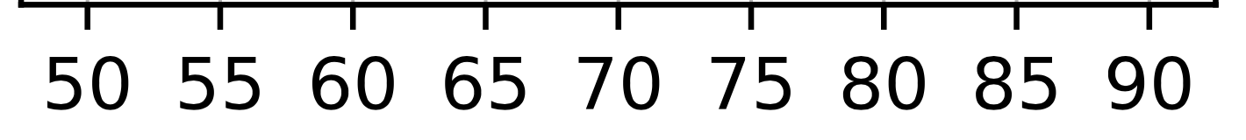
Attack Improvement 1: Making DRAM Cells More Vulnerable
An attacker can manipulate temperature to make the cells that store sensitive data more vulnerable
DRAM cells are vulnerable in a bounded temperature range
no bit flips
Vulnerable Temperature Range
no bit flips
Temperature
50°C
70°C
75°C
65°C
55°C
45°C
Heating up chip temperature
Cooling down chip temperature
Notes:
In the first example for an attack improvement, the attacker manipulates the DRAM module’s temperature to increase the RowHammer vulnerability of the cells that store sensitive data [CLICK]
We observe that DRAM cells are vulnerable to RowHammer in a bounded temperature range [CLICK]
that we call vulnerable temperature range [CLICK]
For example, let this range be from 50 to 70 degrees celsius for the victim cells
To attack the cells within their vulnerable temperature range, an attacker can [CLICK]
heat up the chip if its current temperature is below 50 [CLICK]
Or cool down the chip if its current temperature is above 70 degrees celsius [CLICK]

Slide 80
Key Takeaways from Spatial Variation Analysis

In-Chip
Variations
Key Takeaway 1
RowHammer vulnerability significantly varies
across DRAM rows and columns due to design and manufacturing-process
Key Takeaway 2
Minimum hammer count to induce the first bitflip (HC_{first}) significantly varies across rows in a subarray
but not as much across subarrays
Notes:
In this analysis, we investigate how the RowHammer vulnerability varies based on a victim DRAM cell's physical location
We have two key takeaways from this analysis. [CLICK]
First, The RowHammer vulnerability significantly varies across DRAM rows and columns due to both design induced and manufacturing process induced variation [CLICK]
Second, the distribution of HCfirst exhibits
- a diverse set of values within a subarray
- But similar values across subarrays within a DRAM module [CLICK]

Slide 81
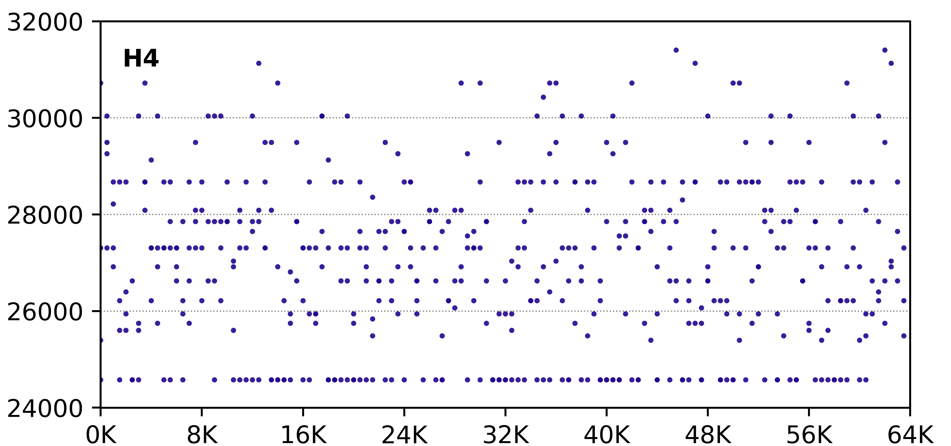
Regularity in Spatial Variation of Read Disturbance across DRAM Rows
No visible regularity in HC_{first} based on the row’s location
The minimum hammer count
to induce the first bitflip (HC_{first})
DRAM Row Address
The minimum hammer count to induce the first bitflip
irregularly varies with respect to row’s location in DRAM bank
Notes:
There are different bins but do not correlate well with the row address

Slide 82
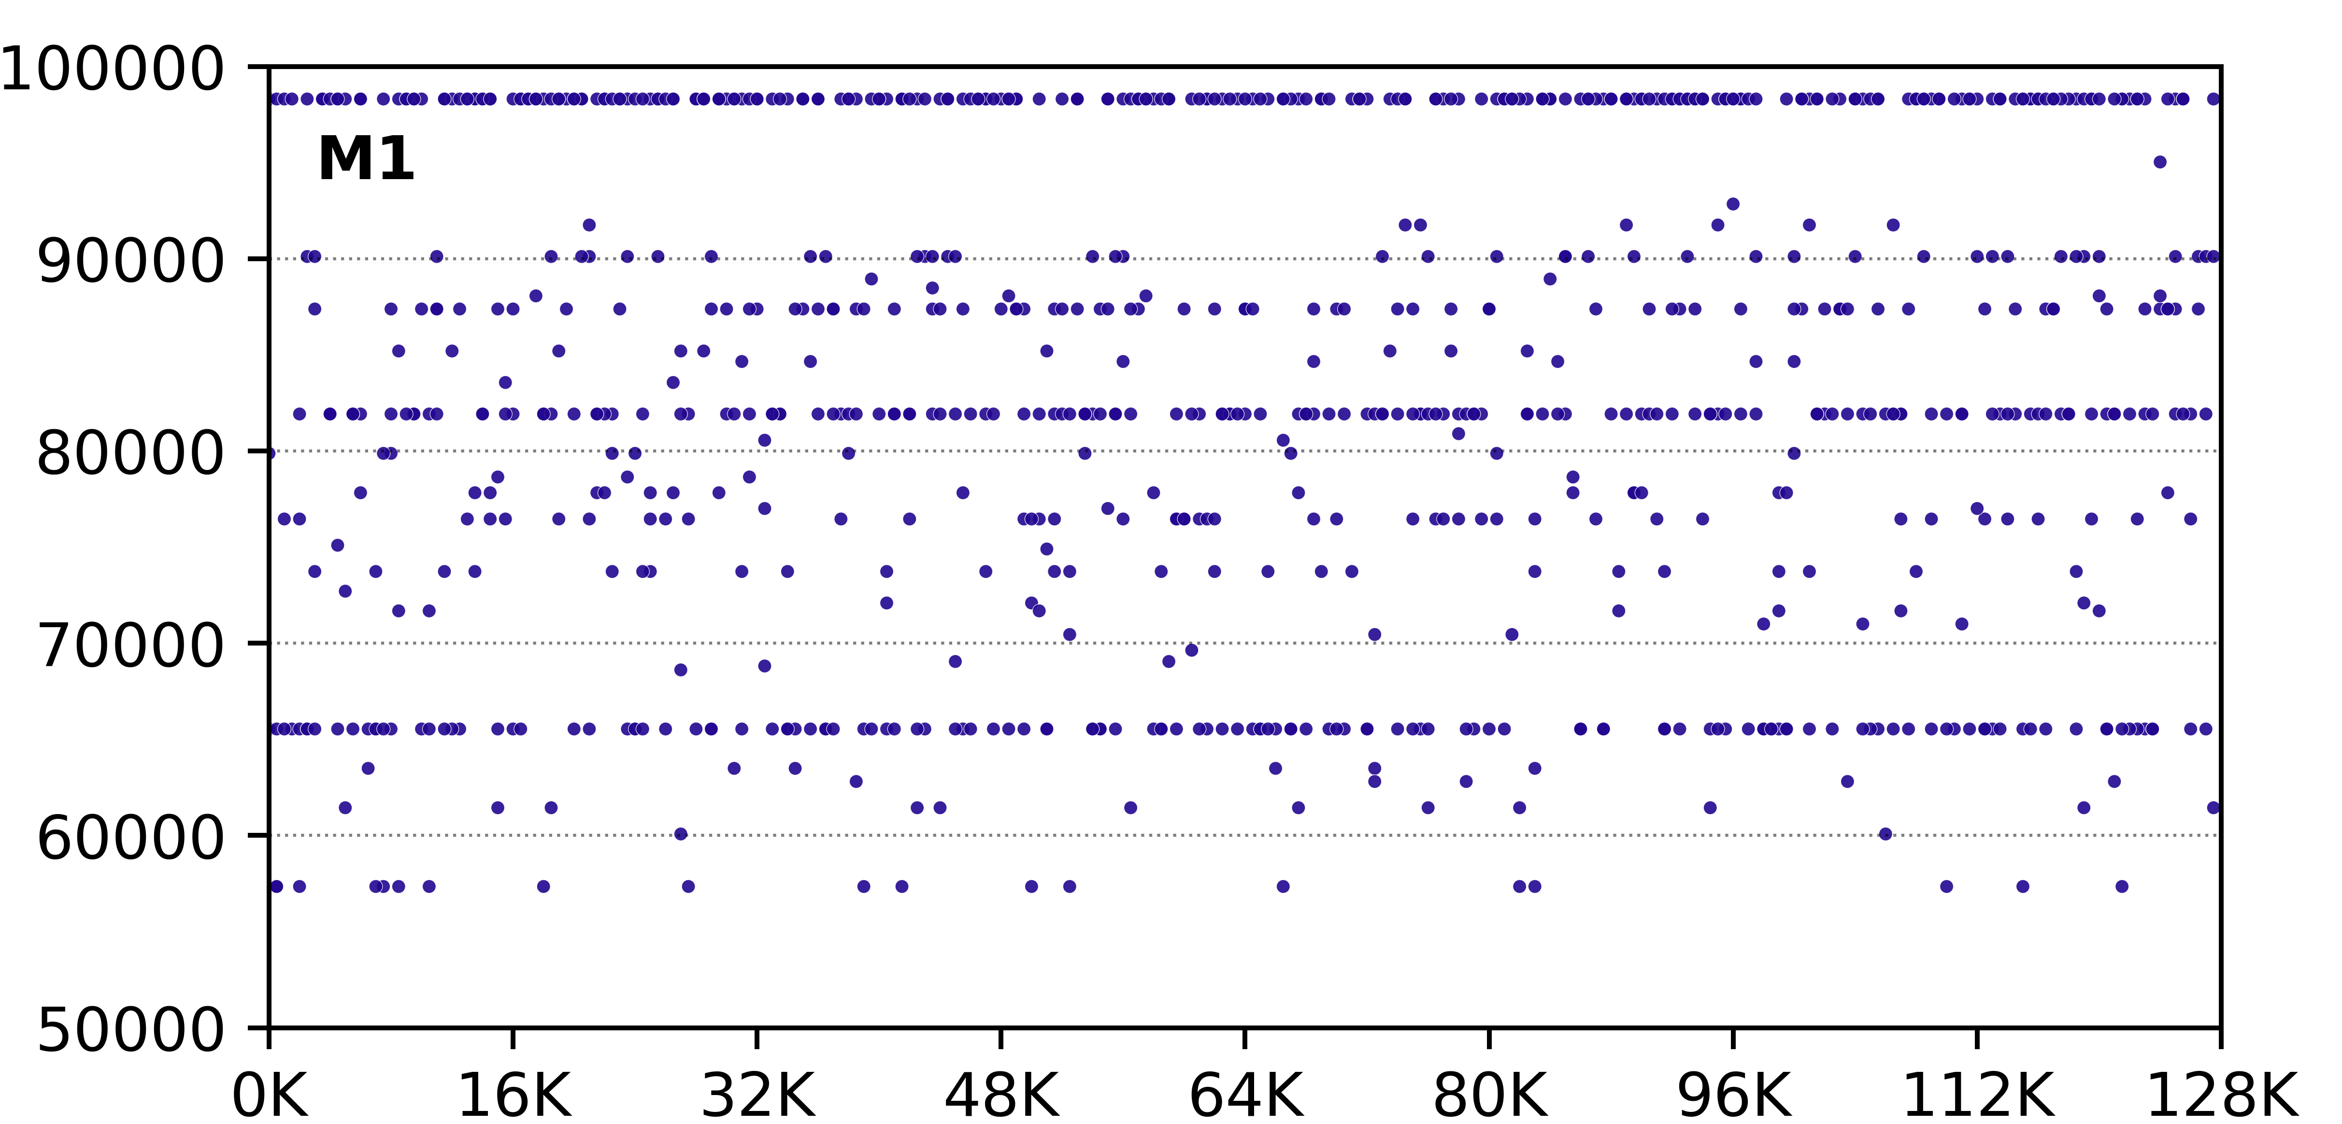
Regularity in Spatial Variation of Read Disturbance across DRAM Rows
No visible regularity in HC_{first} based on the row’s location
The minimum hammer count
to induce the first bitflip (HC_{first})
DRAM Row Address
The minimum hammer count to induce the first bitflip
irregularly varies with respect to row’s location in DRAM bank
Notes:
There are different bins but do not correlate well with the row address

Slide 83
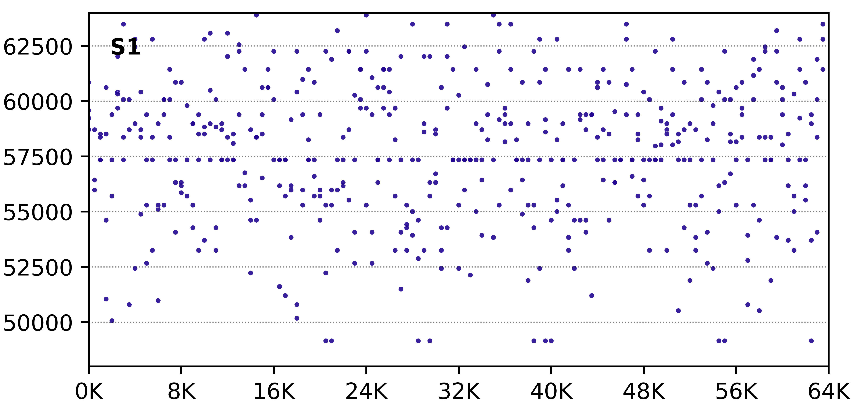
Regularity in Spatial Variation of Read Disturbance across DRAM Rows
No visible regularity in HC_{first} based on the row’s location
The minimum hammer count
to induce the first bitflip (HC_{first})
DRAM Row Address
The minimum hammer count to induce the first bitflip
irregularly varies with respect to row’s location in DRAM bank
Notes:
There are different bins but do not correlate well with the row address

Slide 84
Predictability of Read Disturbance Vulnerability
Predictability of a DRAM row’s read disturbance vulnerability based on the row’s spatial features
bank address bits
subarray address bits
row address bits
row’s distance to local row buffer
Methodology
Cluster DRAM rows into 15 bins based on each row’s minimum hammer count to induce the first bitflip (HC_{first})
Predict whether a row is in a cluster, based on each spatial feature
Measure the F1 score for these predictions
Key Result: Only a few spatial features have F1 scores > 0.7 only for Mfr. S
A row’s spatial features are weak predictors for the row’s read disturbance vulnerability

Slide 85
My Dissertation Works
A deeper look into DRAM read disturbance
Solutions to DRAM read disturbance

Temperature

Memory Access Patterns

In-Chip
Variations
Voltage

Leveraging
Heterogeneity
Throttling Unsafe Accesses
Parallelizing Preventive Measures
Notes:
I also developed solutions that [CLICK]
throttle unsafe accesses [CLICK
parallelize maintenance operations [CLICK]
and leverage heterogeneity [CLICK]
Let me quickly explain one of these works [CLICK]

Slide 86
A Closer Look into RowHammer
Low Voltage
Victim Row
Agressor Row
Wordline Voltage
Low Voltage
Victim Row
time
Aggressor Row
Low Voltage
Aggressor Row
Disturbance
High Voltage
Repeatedly toggling
wordline voltage
is the key to inducing RowHammer bitflips
Low Voltage
Victim Row
Low Voltage
Victim Row
Bitline
Notes:
This cartoon provides a closer look into RowHammer. [CLICK]
Asserting high voltage to a row’s wordline for row activation disturbs nearby rows [CLICK]
Repeating this operation [CLICK] many times [CLICK] exacerbates the leakage in victim rows and leads to bit flips [CLICK]
Therefore, repeatedly toggling wordline voltage is the key to induce RowHammer bit flips [CLICK]

Slide 87
Our Key Finding
Reducing wordline voltage
reduces RowHammer vulnerability
without significantly affecting reliable DRAM operation
Wordline
Voltage
Wordline
Voltage
time
time
Aggressor Row
Aggressor Row
Victim Row
Reduction in Disturbance
Victim Row
Bitline
Bitline
Wordline
Wordline
Weaker Channel in Access Transistor
Strong Channel
Weaker Channel
Notes:
In this work, we hypothesize that [CLICK]
Lowering the magnitude of wordline voltage [CLICK]
can reduce RowHammer vulnerability [CLICK]
without significantly affecting reliable DRAM operation [END]

Slide 88
My Dissertation Works
A deeper look into DRAM read disturbance
Solutions to DRAM read disturbance

Temperature

Memory Access Patterns

In-Chip
Variations
Voltage

Leveraging
Heterogeneity
Throttling Unsafe Accesses
Parallelizing Preventive Measures
Notes:
I also developed solutions that [CLICK]
throttle unsafe accesses [CLICK
parallelize maintenance operations [CLICK]
and leverage heterogeneity [CLICK]
Let me quickly explain one of these works [CLICK]

Slide 89
Compatibility with Commodity DRAM Chips
A RowHammer attack hammers Row A
Existing mechanisms detect the attack
Refresh rows A+1 and A-1
Bit flips still may occur due to unknown DRAM-internal row mapping
Row A+1
Row A-1
Victim
Rows
Row A
Physical
Row Layout
Existing read disturbance mitigation mechanisms need to know proprietary DRAM-internal row address mapping
Notes:
Assume that an attacker hammers a row to induce bit flips in its nearby rows [CLICK]
Existing mitigation mechanisms detect the attack [CLICK]
And try refreshing the nearby rows [CLICK]
However, the DRAM chip can internally map these row addresses to different physical rows [CLICK]
And thus bit flips may still occur[CLICK]
To avoid this, existing mechanisms need to know proprietary DRAM-internal row address mapping [CLICK]

Slide 90

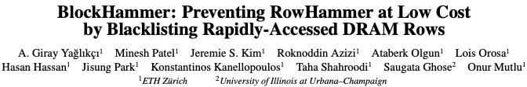
BlockHammer – HPCA 2021
A. Giray Yaglikci, Minesh Patel, Jeremie S. Kim, Roknoddin Azizi, Ataberk Olgun, Lois Orosa, Hasan Hassan, Jisung Park, Konstantinos Kanellopoulos, Taha Shahroodi, Saugata Ghose, and Onur Mutlu, "BlockHammer: Preventing RowHammer at Low Cost by Blacklisting Rapidly-Accessed DRAM Rows" Proceedings of the 27th International Symposium on High-Performance Computer Architecture (HPCA), Virtual, February-March 2021. [Slides (pptx) (pdf)] [Short Talk Slides (pptx) (pdf)] [Intel Hardware Security Academic Awards Short Talk Slides (pptx) (pdf)] [Talk Video (22 minutes)] [Short Talk Video (7 minutes)] [Intel Hardware Security Academic Awards Short Talk Video (2 minutes)] [BlockHammer Source Code] Intel Hardware Security Academic Award Finalist (one of 4 finalists out of 34 nominations)
Notes:
We provide more analyses and implementation details available in the full paper.
[CLICK] First, the paper shares a security proof where we mathematically represent ALL POSSIBLE access patterns and show that NO ROW can be activated at a high-enough rate to induce bit-flips when BlockHammer is configured correctly.
[CLICK] Second, the paper explains how BlockHammer addresses many-sided attacks by tuning its thresholds.
[CLICK] Third, we evaluate all four high-level RowHammer mitigation approaches through analyzing 14 mechanisms from four aspects
[CLICK] comprehensive protection
[CLICK] compatibiltiy with commodity DRAM chips
[CLICK] scalability with worsening RowHammer vulnerability
[CLICK] and deterministic protection.
[CLICK] We show that BlockHammer is the only mechanism that satisfies all of them.
[END]

Slide 91
BlockHammer: Throttling Unsafe Accesses
A RowHammer attack hammers Row A
BlockHammer detects and selectively throttles accesses from within the memory controller
Bit flips do not occur
BlockHammer can optionally inform the system software about the attack
Row A
Physical
Row Layout
BlockHammer is compatible with commodity DRAM chips
No need for proprietary info of or modifications to DRAM chips
Notes:
In contrast, BlockHammer detects and selectively throttles the attack’s memory accesses [CLICK]
Therefore, the row’s activation count cannot reach critical levels, and no bit flip occurs [CLICK]
BlockHammer can optionally inform the system software about the attack for higher-level countermeasures [CLICK]
BlockHammer achieves all of these without needing proprietary information of or modifications to commodity DRAM chips [CLICK]

Slide 92

Spatial Variation-Aware Read Disturbance Defenses: Experimental Analysis of Real DRAM Chips and Implications on Future Solutions
Aging Slides
Full Paper
arXiv [cs.CR] 2402.18652
Abdullah Giray Yağlıkçı
Yahya Can Tuğrul Geraldo F. Oliveira İsmail Emir Yüksel
Ataberk Olgun Haocong Luo Onur Mutlu
Notes:
Hi my name is Giray and I am happy to share my research with you

Slide 93
More in the Paper (2/2): Aging Study
Preliminary data on aging via 68-day of continuous hammering
Aging can lead to read disturbance bitflips at smaller hammer counts
Minimum hammer count to induce the first bitflip HC_{first} (after aging)
Minimum hammer count to induce the first bitflip HC_{first} (after aging)
Minimum hammer count to induce the first bitflip HC_{first} (before aging)
Minimum hammer count to induce the first bitflip HC_{first} (before aging)

Slide 94
More in the Paper (2/2): Aging Study
Preliminary data on aging via 68-day of continuous hammering
Aging can lead to read disturbance bitflips at smaller hammer counts
Minimum hammer count to induce the first bitflip HC_{first} (after aging)
Minimum hammer count to induce the first bitflip HC_{first} (after aging)
Future work:
rigorous aging characterization
and online profiling of read disturbance vulnerability
Minimum hammer count to induce the first bitflip HC_{first} (before aging)
Minimum hammer count to induce the first bitflip HC_{first} (before aging)

Slide 95
Spatial Variation-Aware Read Disturbance Defenses: Experimental Analysis of Real DRAM Chips and Implications on Future Solutions
Hydra’s Performance
Full Paper
arXiv [cs.CR] 2402.18652
Abdullah Giray Yağlıkçı
Yahya Can Tuğrul Geraldo F. Oliveira İsmail Emir Yüksel
Ataberk Olgun Haocong Luo Onur Mutlu
Notes:
Hi my name is Giray and I am happy to share my research with you

Slide 96
An Outlier Solution: Hydra
Weighted Speedup
(Norm. to No Mitigation Baseline)
Only 7% Speedup
Minimum Hammer Count to Induce the First Bitflip

Slide 97
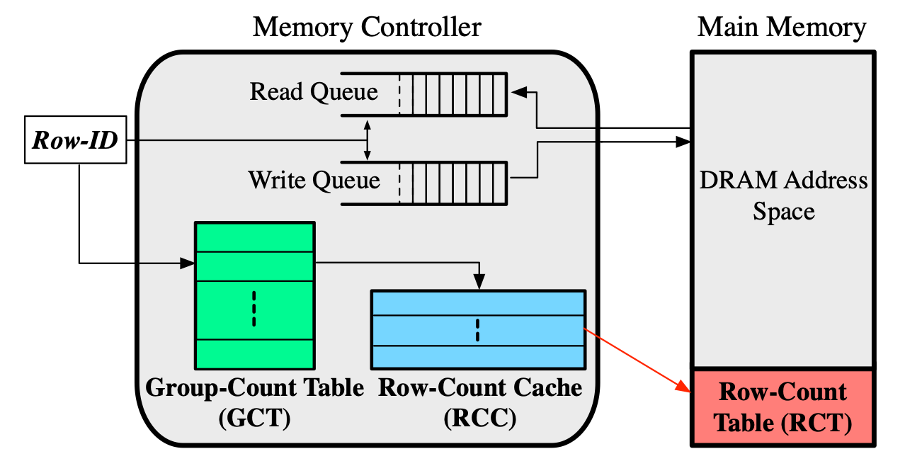
Hydra Mitigation Mechanism
Hydra maintains a row activation counter for each DRAM row
Stores these activation counters in the DRAM array
Caches the counters of hot rows in the memory controller
At low HC_{first} configurations, many rows are hot
Fetching / evicting counters dominate the performance overhead
Svärd needs further customizations for Hydra
Qureshi, et al. "Hydra: Enabling Low-Overhead Mitigation of Row-Hammer at Ultra-Low Thresholds via Hybrid Tracking," in ISCA, 2022.

Slide 98
Spatial Variation-Aware Read Disturbance Defenses: Experimental Analysis of Real DRAM Chips and Implications on Future Solutions
HC_{first} across Rows
Full Paper
arXiv [cs.CR] 2402.18652
Abdullah Giray Yağlıkçı
Yahya Can Tuğrul Geraldo F. Oliveira İsmail Emir Yüksel
Ataberk Olgun Haocong Luo Onur Mutlu
Notes:
Hi my name is Giray and I am happy to share my research with you

Slide 99
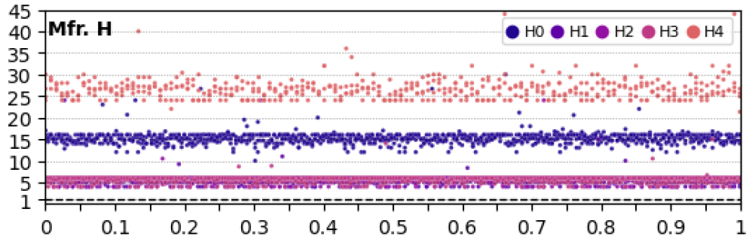
The Minimum Hammer Count to Induce the First Bitflip across DRAM Rows
No visible regularity in HC_{first} based on the row’s location
The minimum hammer count
to induce the first bitflip (HC_{first}) Norm. to the Lowest Hc_{first} in the module
Relative location of a DRAM row
(0 and 1 are the two edges of a DRAM bank)
The minimum hammer count to induce the first bitflip
irregularly varies with respect to row’s location in DRAM bank

Slide 100
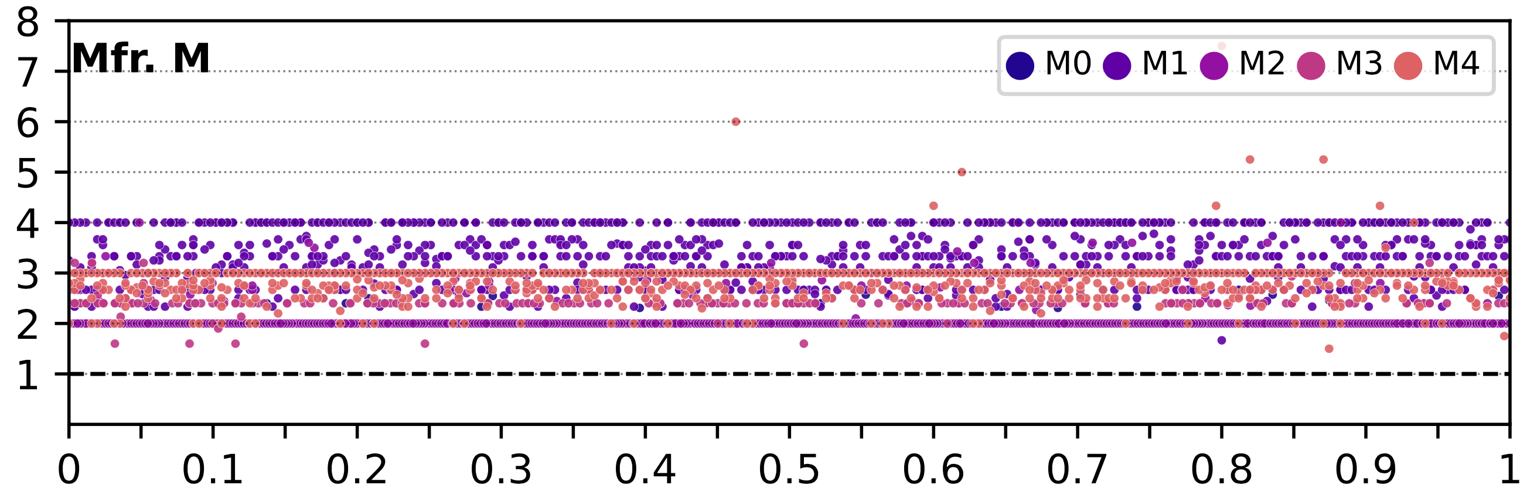
The Minimum Hammer Count to Induce the First Bitflip across DRAM Rows
No visible regularity in HC_{first} based on the row’s location
The minimum hammer count
to induce the first bitflip (HC_{first}) Norm. to the Lowest Hc_{first} in the module
Relative location of a DRAM row
(0 and 1 are the two edges of a DRAM bank)
The minimum hammer count to induce the first bitflip
irregularly varies with respect to row’s location in DRAM bank

Slide 101
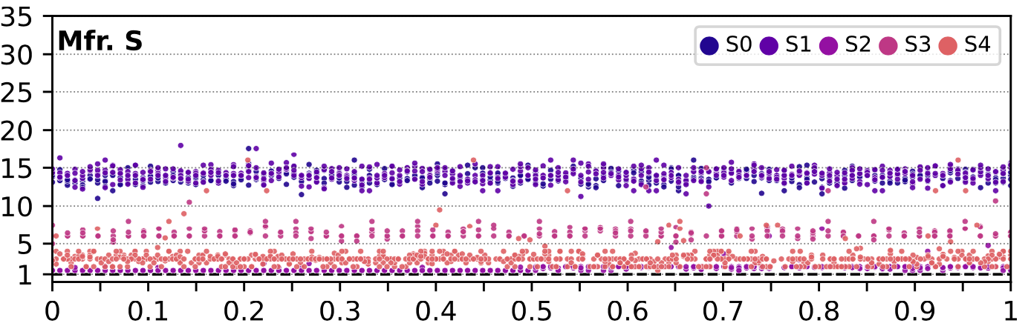
The Minimum Hammer Count to Induce the First Bitflip across DRAM Rows
No visible regularity in HC_{first} based on the row’s location
The minimum hammer count
to induce the first bitflip (HC_{first}) Norm. to the Lowest Hc_{first} in the module
Relative location of a DRAM row
(0 and 1 are the two edges of a DRAM bank)
The minimum hammer count to induce the first bitflip
irregularly varies with respect to row’s location in DRAM bank

Slide 102
Spatial Variation-Aware Read Disturbance Defenses: Experimental Analysis of Real DRAM Chips and Implications on Future Solutions
BER across Rows
Full Paper
arXiv [cs.CR] 2402.18652
Abdullah Giray Yağlıkçı
Yahya Can Tuğrul Geraldo F. Oliveira İsmail Emir Yüksel
Ataberk Olgun Haocong Luo Onur Mutlu
Notes:
Hi my name is Giray and I am happy to share my research with you

Slide 103
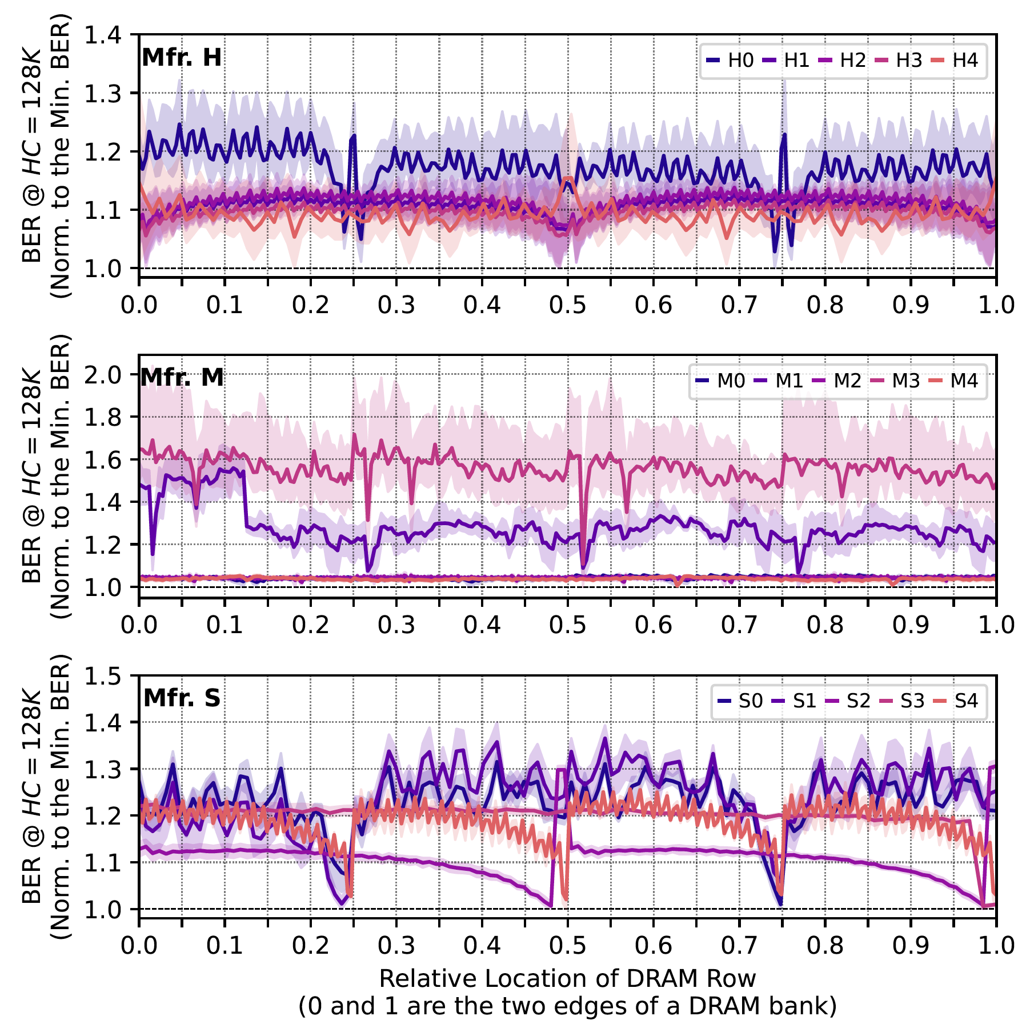
The Read Disturbance Bit Error Rate across DRAM Rows
Bit error rate periodically increases and decreases
Relative location of a DRAM row
(0 and 1 are the two edges of a DRAM bank)
The variation in read disturbance bit error rate
exhibits a stronger regularity compared to the variation in varies with respect to row’s location in DRAM bank

Slide 104
The Read Disturbance Bit Error Rate across DRAM Rows
Bit error rate periodically increases and decreases
Relative location of a DRAM row
(0 and 1 are the two edges of a DRAM bank)
The variation in read disturbance bit error rate
exhibits a stronger regularity compared to the variation in varies with respect to row’s location in DRAM bank

Slide 105
The Read Disturbance Bit Error Rate across DRAM Rows
Bit error rate periodically increases and decreases
Relative location of a DRAM row
(0 and 1 are the two edges of a DRAM bank)
The variation in read disturbance bit error rate
exhibits a stronger regularity compared to the variation in varies with respect to row’s location in DRAM bank

Slide 106
Spatial Variation-Aware Read Disturbance Defenses: Experimental Analysis of Real DRAM Chips and Implications on Future Solutions
Background
Full Paper
arXiv [cs.CR] 2402.18652
Abdullah Giray Yağlıkçı
Yahya Can Tuğrul Geraldo F. Oliveira İsmail Emir Yüksel
Ataberk Olgun Haocong Luo Onur Mutlu
Notes:
Hi my name is Giray and I am happy to share my research with you

Slide 107

Two Main Types of DRAM Refresh
Periodic Refresh: Periodically restores the charge DRAM cells leak over time
1
RowHammer: Repeatedly accessing a DRAM row can cause bit flips in other physically nearby rows
2
Preventive Refresh
DRAM Row
Preventive Refresh
Preventive Refresh: Mitigates RowHammer by refreshing physically nearby rows of a repeatedly accessed row
Notes:
DRAM Refresh is mainly used for two purposes [CLICK]
The first one is called: Periodic Refresh to periodically restore the charge that DRAM cells leak over time [CLICK]
The second one is relevant to a read-disturb error mechanism called RowHammer, where repeatedly accessing a DRAM row can cause bit flips in other physically near by rows [CLICK]
A common method of mitigating RowHammer is refreshing potentially affected rows, called preventive refresh [CLICK]

Slide 108
Periodic Refresh with Increasing DRAM Chip Density
A larger capacity chip has more rows to be refreshed
A smaller cell stores less charge
26% Slowdown
More periodic refresh operations incur larger performance overhead as DRAM chip density increases
Significant performance and energy overhead
Notes:
With increasing DRAM chip density, [CLICK]
More rows need to be refreshed [CLICK]
And cells can store smaller charge leading to more periodic refresh operations[CLICK]
In this plot, we sweep DRAM chip capacity on the x-axis and investigate how the performance overhead of DRAM refresh operations change[CLICK]
We observe 26% slowdown in system performance caused by periodic refreshes [CLICK]

Slide 109
Spatial Variation-Aware Read Disturbance Defenses: Experimental Analysis of Real DRAM Chips and Implications on Future Solutions
RowPress
Full Paper
arXiv [cs.CR] 2402.18652
Abdullah Giray Yağlıkçı
Yahya Can Tuğrul Geraldo F. Oliveira İsmail Emir Yüksel
Ataberk Olgun Haocong Luo Onur Mutlu
Notes:
Hi my name is Giray and I am happy to share my research with you

Slide 110
DRAM Organization
Subarray
Bitline
DRAM Cell
Bank
Wordline
…
Chip I/O
. . .
DRAM Row
…
…
…
…
…
Row Buffer
DRAM Chip
DRAM Bank
DRAM Subarray
Notes:
This is a DRAM module, used as the main memory on many systems. [CLICK]
A DRAM module consists of multiple chips each of which contains multiple banks [CLICK]
Each bank is composed of multiple subarrays [CLICK]
And within each subarray, there is a two dimensional array of DRAM cells. [CLICK]
These cells are organized into rows that are selected using wordlines [CLICK]
And the cells are connected to a row buffer via bitlines [CLICK]

Slide 111
DRAM Operation
Bitline
DRAM Cell
Wordline
Wordline
Access transistor
…
DRAM Subarray
…
DRAM Cell
charge
leakage
paths
Capacitor
Bitline
…
…
…
…
Row Buffer
Refresh: Restores the capacitor voltage with a time period called refresh window
I/O Circuitry
Row Activation: Fetch the row’s content into the row buffer
Column Access: Read/Write a column in the row buffer
Precharge: Disconnect the row from the row buffer
Notes:
This is a simplified diagram of a DRAM cell, where the data is stored as capacitor voltage and accessed through the access transistor [CLICK]
A DRAM cell inherently exhibits several charge leakage paths [CLICK]
And requires to perform refresh operations to restore the capacitor voltage with a time period called refresh window.
[PAUSE]
To access a DRAM cell, [CLICK]
the memory controller must first open or activate the row to fetch the row’s data into the row buffer [CLICK]
The READ and WRITE requests targeting the row are serviced from the row buffer [CLICK]
After all requests are serviced from the row, the memory controller must close or precharge the row in order to begin accessing data from another row. [CLICK]

Slide 112
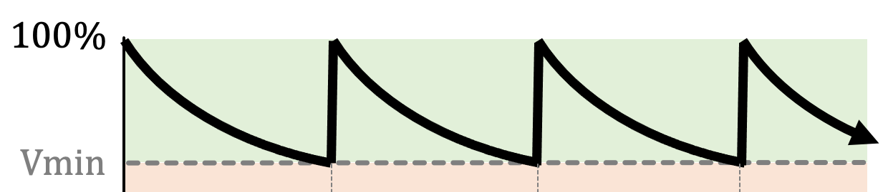
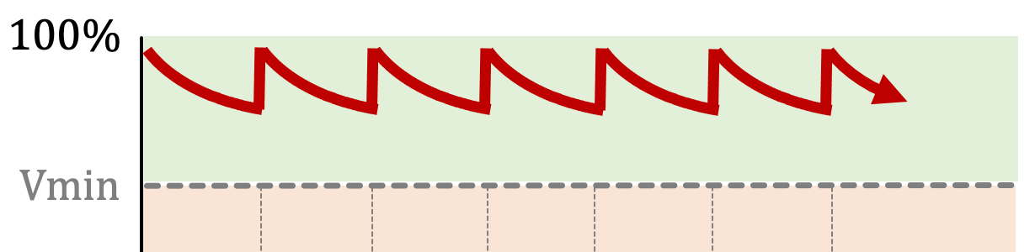


RowHammer Mitigation Approaches
Increased refresh rate
Physical isolation
Reactive refresh
Proactive throttling
REF-to-REF time reduces
Fewer activations can fit
DRAM Bank
Aggressor Row
Isolation Rows
Large-enough distance
Victim Rows
DRAM Bank
Victim Rows
Refresh
Aggressor Row
Rapidly activated (hammered)
Victim rows
Refresh
Fewer activations can be performed
Notes:
There are four high-level RowHammer mitigation approaches.
[CLICK] The first approach is to increase refresh rate
[CLICK] which reduces the refresh window,
[CLICK] and thus the activation count that an attacker can reach in a refresh window.
[CLICK] The second approach is to physically isolate
[CLICK] potential victim rows with sensitive data
[CLICK] from aggressor rows that a potential attacker can hammer
[CLICK] by allocating isolation rows in between
such that the attacker cannot disturb sensitive data by performing RowHammer attack.
[CLICK] The third approach is reactive refresh.
[CLICK] In this approach, when an aggressor row is hammered
[CLICK] potential victim rows are refreshed to avoid bit-flips.
[CLICK] Finally the fourth approach suggests
[CLICK] throttling or slowing down memory accesses proactively such that no row’s activation rate can reach RowHammer threshold.

Slide 113
RowHammer Mitigation across Generations
10⁵
10⁴
10³
10²
Ideal
14%
TWiCe-ideal
PARA
LPDDR4-1x
LPDDR4-1y
DDR3-old
DDR3-new
DDR4-new
DDR4-old
10⁵
10⁴
10³
10²
HC_{first} (number of hammers required to induce first RowHammer bit flip)
J. S. Kim, M. Patel, A. G. Yaglikci, H. Hassan, R. Azizi, L. Orosa, and O. Mutlu, "Revisiting RowHammer: An Experimental Analysis of Modern Devices and Mitigation Techniques,” in ISCA, 2020.

Slide 114
RowPress [ISCA 2023]
Haocong Luo, Ataberk Olgun, Giray Yaglikci, Yahya Can Tugrul, Steve Rhyner, M. Banu Cavlak, Joel Lindegger, Mohammad Sadrosadati, and Onur Mutlu, "RowPress: Amplifying Read Disturbance in Modern DRAM Chips" Proceedings of the 50th International Symposium on Computer Architecture (ISCA), Orlando, FL, USA, June 2023. [Slides (pptx) (pdf)] [Lightning Talk Slides (pptx) (pdf)] [Lightning Talk Video (3 minutes)] [RowPress Source Code and Datasets (Officially Artifact Evaluated with All Badges)] Officially artifact evaluated as available, reusable and reproducible. Best artifact award at ISCA 2023.

Slide 115
RowPress A New DRAM Read Disturbance Phenomenon
DRAM Subarray
Row 0
Row 1
Row 1
Row 1
Victim Row
Row 2
Row 2
Row 2
Row 2
Row 2
open
open
open
closed
Aggressor Row
Aggressor Row
Row 3
Row 3
Row 3
Row 2
Victim Row
closed
Row 4
Keeping a DRAM row open (activated)
causes RowPress bitflips in nearby cells
Notes:
Due to an increase in cell-to-cell interference, as a result of aggressive technology node scaling, rapidly activating [CLICK] and precharging
[FORTH & BACK] a DRAM row can result in bit flips in physically adjacent rows [CLICK]
[FORTH & BACK] Continuing to access the same row results in even more failures in nearby rows. This phenomenon is known as RowHammer. [CLICK]
We refer to the rapidly accessed row as an aggressor row and the rows containing bit flips as victim rows.

Slide 116
Two Prime Examples of DRAM Read Disturbance: RowHammer and RowPress
Instead of using a high activation count,
☞ increase the time that the aggressor row stays open
RowHammer
Aggressor Row
Open
Close
RowPress
Aggressor Row
Open
Close
Notes:
Instead of a high activation count, RowPress increases the time the that aggressor stays open.
Doing disturbs adjacent rows enough to cause bitflips without a very high activation count.
We observe bitflips even with only one activation in extreme cases.

Slide 117
RowPress [ISCA 2023]
Haocong Luo, Ataberk Olgun, Giray Yaglikci, Yahya Can Tugrul, Steve Rhyner, M. Banu Cavlak, Joel Lindegger, Mohammad Sadrosadati, and Onur Mutlu, "RowPress: Amplifying Read Disturbance in Modern DRAM Chips" Proceedings of the 50th International Symposium on Computer Architecture (ISCA), Orlando, FL, USA, June 2023. [Slides (pptx) (pdf)] [Lightning Talk Slides (pptx) (pdf)] [Lightning Talk Video (3 minutes)] [RowPress Source Code and Datasets (Officially Artifact Evaluated with All Badges)] Officially artifact evaluated as available, reusable and reproducible. Best artifact award at ISCA 2023.

Slide 118
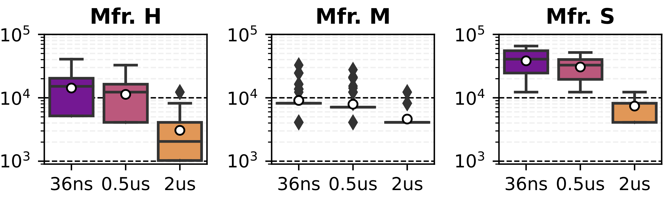
Effect of RowPress on Spatial Variation of Read Disturbance Vulnerability across Rows
Effect of RowPress on the HC_{first} Distribution
Minimum Hammer Count
To Induce the First Bitflip
(HC_{first})
Aggressor Row’s On Time (t_{AggOn}) (ns)
RowPress reduces the mean of the distribution with increased t_{AggOn}
There is still significant variation in the HC_{first} across rows

Slide 119
Effect of RowPress on the HCfirst Distribution
Minimum Hammer Count
To Induce the First Bitflip
(HC_{first})
Aggressor Row’s On Time (t_{AggOn}) (ns)
Aggressor Row’s On Time (t_{AggOn}) (ns)
Bitflips occur at lower hammer counts with RowPress and these hammer counts still significantly vary across DRAM rows
Notes:
Assume that an attacker hammers a row to induce bit flips in its nearby rows [CLICK]
Existing RowHammer defenses detect the attack [CLICK]
And try refreshing the nearby rows [CLICK]
However, the DRAM chip can internally map these row addresses to different physical rows [CLICK]
And thus bit flips may still occur[CLICK]
To avoid this, existing mechanisms need to know proprietary DRAM-internal row address mapping [CLICK]

Slide 120
Spatial Variation-Aware Read Disturbance Defenses: Experimental Analysis of Real DRAM Chips and Implications on Future Solutions
Predictability
Full Paper
arXiv [cs.CR] 2402.18652
Abdullah Giray Yağlıkçı
Yahya Can Tuğrul Geraldo F. Oliveira İsmail Emir Yüksel
Ataberk Olgun Haocong Luo Onur Mutlu
Notes:
Hi my name is Giray and I am happy to share my research with you

Slide 121
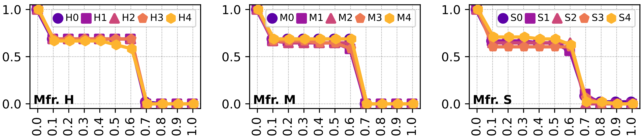
Cumulative Distribution of Spatial Features based on F1 Score
Different DRAM modules
More than 50% of the features have F1 scores larger than 0.1
Cumulative Distribution
of Spatial Features
F1 score
Weak prediction observed between a row’s spatial features & read disturbance vulnerability
Notes:
Make the x-axis more intuitive

Slide 122
Cumulative Distribution of Spatial Features based on F1 Score
Different DRAM modules
Cumulative Distribution of Spatial Features
F1 score
F1 score
F1 score
A few spatial features from Mfr. S can exhibit F1 score >0.7
Weak prediction observed between a row’s spatial features & read disturbance vulnerability
Notes:
Make the x-axis more intuitive

Slide 123
Spatial Variation-Aware Read Disturbance Defenses: Experimental Analysis of Real DRAM Chips and Implications on Future Solutions
Implementation Details
Full Paper
arXiv [cs.CR] 2402.18652
Abdullah Giray Yağlıkçı
Yahya Can Tuğrul Geraldo F. Oliveira İsmail Emir Yüksel
Ataberk Olgun Haocong Luo Onur Mutlu
Notes:
Hi my name is Giray and I am happy to share my research with you

Slide 124
Svärd: Spatial Variation-Aware Read Disturbance Defenses Integration Examples with Existing Defenses
Integrate Svärd with five solutions
1) PARA [Kim+, ISCA’14]
Generates a random number
Compares the random number with a threshold
Refreshes the victim row if the random number exceeds the threshold
2) BlockHammer [Yaglikci+, HPCA’21]
Counts the number of activations of DRAM rows
Compares the activation count with a threshold
Throttles accesses to the aggressor row if the activation count reaches the threshold
3) Hydra [Qureshi+, ISCA’22]
Counts the number of activations of DRAM rows
Compares the activation count with a threshold
Refreshes the victim row when the activation count reaches the threshold
4) AQUA [Saxena+, MICRO’22] and 5) RRS [Saileshwar+, ASPLOS’22]
Counts the number of activations of DRAM rows
Compares the activation count with a threshold
Relocates the aggressor row when the activation count reaches the threshold
Svärd tunes the threshold based on the victim row’s vulnerability
Notes:
We leverage this observation [CLICK]
By protecting weak rows more aggressively than strong rows [CLICK]
We do this by dynamically tuning the aggressiveness of defense mechanisms [CLICK]
and we show significant improvement in system performance. [CLICK]
Too high level
Put ataberk’s explanation here

Slide 125
Svärd: Spatial Variation-Aware Read Disturbance Defenses Example Implementation 1
Classifies DRAM rows into several vulnerability-level bins
Maintains a few (e.g., four) bits per DRAM row
Implemented in either the memory controller or the DRAM chip
Two example memory controller-based implementations:
Memory Controller
Memory
Request
DRAM Commands, Address, Data
Memory
Request
Scheduler
HC_{first} Table
Row
Addr
Existing Read
Disturbance
Solution
DRAM
Chip
HC_{first}
Metadata
Bits
Preventive Action
Data
Two potential ways of handling metadata
Notes:
Too busy
Make either or more obvious
Table in the dram chip
Why memory controllers?
s/w based metadata?

Slide 126
Svärd: Spatial Variation-Aware Read Disturbance Defenses Example Implementation 2
Classifies DRAM rows into several vulnerability-level bins
Maintains a few (e.g., four) bits per DRAM row
Implemented in either the memory controller or the DRAM chip
An example DRAM chip-based implementation:
Additional few (e.g., four) bits per DRAM row (e.g., 8Kb)
DRAM Chip
DRAM
command
address
data
DRAM Subarray
DRAM Row
Existing Read
Disturbance
Solution
DRAM Row
Refresh
Controller
I/O Periphery
DRAM Row
HC_{first} Bin
Row Buffer
Preventive Action
Data

Slide 127
Spatial Variation-Aware Read Disturbance Defenses: Experimental Analysis of Real DRAM Chips and Implications on Future Solutions
Backup Slides
Abdullah Giray Yağlıkçı
Yahya Can Tuğrul Geraldo F. Oliveira İsmail Emir Yüksel
Ataberk Olgun Haocong Luo Onur Mutlu
Notes:
Hi my name is Giray and I am happy to share my research with you

